Slide 1
Using designs for crossing numbers and midrange crossing constants of graph classes
László A. Székely
University of South Carolina
In collaboration with
John Asplund, Eva Czabarka, Gregory Clark, Garner Cochran, Arrun Hamm, Inne Singgih, Gwen Spencer, Josiah Reiswig, Libby Taylor, Zhiyu Wang
Rényi Geometry Webinar, May 1, 2020

Slide 2
Harary-Hill conjecture
Achieved in several different ways:
  Soup can drawing (Harary, Hill, 1963)
  Throwing different slopes to different hemispheres (Blazek-Koman, 1964)
  Non-shellable optimal drawings exist
Proved for shellable drawings (0% of all drawings, Abrego, Aichholzer, Fernandez-Merchant, Ramos, Salazar, 2013)
Lower bound at 98.5% of conjecture (Balogh, Lidicky, Salazar 2018)
Limit of cr(K_{n})/n⁴ exists, conjectured to be 1/64

Slide 3
Blažek-Koman slope drawing of K₅
Positive slopes in one hemisphere
Negative slopes in other hemisphere
This is a 2-page drawing

Slide 4
Soup can drawing of K_{2n} (n=5)

Slide 5
Moon’s Theorem 1965
Take n points on the sphere, i.i.d. uniformly
Join pairs on the shorter arc of great circle
Obtain a random drawing of K_{n}
Expected number of crossings is n⁴/64+O(n³)

Slide 6
Midrange crossing constant Pach, Spencer, G. Tóth (1999)
If n<< m << n²
converges to a constant κ (conjectured by Erdős and Guy ten years before the Crossing Lemma)
Same holds for rectilinear crossing number – with possibly different constant κ’

Slide 7
k-planar crossing number
Biplanar/k-planar crossing number (Owens 1971, Shahroki-Sýkora-Székely-Vrťo 2004, Czabarka-Sýkora-Székely-Vrťo 2003): To find cr_{k}(G), draw k graphs on the same vertex set such that the union of their edges give G and the sum of their crossing numbers is minimal.
Thickness: the minimum k such that cr_{k}(G)=0
Notes:
Thickness 2 graphs are called biplanar

Slide 8
Algorithmic
Is G planar? – linear time solvable (Hopcroft-Tarjan, 1974)
Is G biplanar? - NP-complete (Mansfield, 1983)

Slide 9
k-planar crossing number and crossing number
⅜ Theorem Czabarka-Sýkora-Sz-Vrťo: For all finite simple graphs, cr₂(G)≤ ⅜ cr(G)
What is α_{k} (in particular α₂), where
Owens 1971, Durocher, Gethner, and Mondal 2016: cr₂(K_{n})≤ 7n⁴/1536+O(n³)
7/1536=(7/24)(1/64)
Owens drawing: perhaps α₂=7/24 ?
Use of first moment method gives α_{k} ≤ 1/k

Slide 10
Proof to ⅜ Theorem: Randomized Algorithm
Consider a random bipartition (U;W) of V(G): for every vertex, independently toss a fair coin, and if Head=0 is obtained, add it to U, Tail=1 to V. Now any crossing in D occurs in 6 possible forms, according to which classes the endpoints of the crossing edges belong to:
  UU,UU edges with probability 1/16
  WW,WW edges with probability 1/16
  UW,UW edges with probability 1/4
  UU,WW edges with probability 1/8
  UU,UW edges with probability 1/4
  WW,UW edges with probability 1/4
U
(0)
W
(1)
Notes:
Start with an optimal drawing of G in the plane. Mostly follow this drawing to make a 2-planar drawing.

Slide 11
Randomized Algorithm
In the first plane draw the subdrawings spanned by U and spanned by W, in the second plane draw the subdrawing of edges connecting U to W (sum=0 or 1)
In the second plane we have the UW,UW type crossings, in expectation (1/4)cr(D).
In the first plane, we have the UU,UU and WW,WW type crossings, in total expectation (1/8)cr(D); and also the UU,WW type crossings. Get rid of the latter type of crossing, by a translation of the W point set and its induced edges to sufficiently far away.

Slide 12
Randomized k-planar Algorithm (János Pach, Csaba Tóth, Géza Tóth, Sz 2014)
Theorem: For all positive integer k
For k=2 we get back the ⅜ Theorem
They posed the problem whether k²α_{k} has a limit.

Slide 13
The relevant partition
Assign random residue mod k to nodes. Place edge (i,j) in p^{th} plane when
Odd k, k =5
Even k, k =4

Slide 14
New Results [Asplund, Czabarka, Clark, Cochran, Hamm, Spencer, Sz, Taylor, Wang]
, where

Slide 15
Methodology for obtaining good k-planar drawings
Fix k, select s. Take an optimal drawing D of G realizing cr(G).
Partition the edge set of K_{s}º, the complete graph with a loop on every vertex, into H₁, H₂,…, H_{k}
Map the vertices of G randomly, uniformly, independently to the vertices of K_{s}º
Types: the connected components of H_{i}’s; type of an edge in G is the type it maps to.
G_{i} be the subgraph formed by the edges of G that map to H_{i}. Edges of G with a given type in H_{i} form a union of components of G_{i}
Following the drawing D, draw an edge of G in the i^{th} plane if it maps to H_{i}
In each plane, move by translation the vertex sets that map to different types so far from each other, that only edges of the same type can cross.

Slide 16
Crossings in this k-planar drawing
For an (unordered) pair of crossing edges uv, wz in D, define q=Prob[uv, wz has the same type]
q is independent of the choice of uv, wz
There is a k-planar drawing D* cr_{k}(D*)≤ q cr(G)
α_{k} ≤ q
Czabarka-Sýkora-Sz-Vrťo: k=2, s=k=2, H₁= single edge, H₂= two loops
Pach-Tóth-Tóth-Sz: k arbitrary, s=k
  odd k: H_{i}= one loop and (k – 1)/2 matching edges
  even k: H_{i}= either a perfect matching or two loops and (k – 2)/2 matching edges

Slide 17
Example: k=4, s=7, α_{k} ≤235/2401

Slide 18
Kirkman’s Schoolgirl Problem (1847)
Sun ABC DEF GHI JKL MNO
Mon ADH BEK CIO FLN GJM
Tue AEM BHN CGK DIL FJO
Wed AFI BLO CHJ DKM EGN
Thu AGL BDJ CFM EHO IKN
Fri AJN BIM CEL DOG FHK
Sat AKO BFG CDN EIJ HLM
Notes:
Kirkman, Cayley

Slide 19
Resolvable Balanced Incomplete Block Designs
An RBIBD(s,l,1) is a collection of m partitions P₁, P₂,…, P_{m} of an underlying s-element set, each into l-element subsets, such that every pair of the s-element set is contained by exactly one of the ms/l l-ele-ment sets occurring as partition classes.
s=15, l=3: Kirkman Schoolgirl Problem
l=2: factorization of complete graph into perfect matchings

Slide 20
Resolvable Balanced Incomplete Block Designs
If an RBIBD(s,l,1) exists then the following hold (necessary conditions):
  l divides s (partitions have s/l classes)
  l−1 divides s−1 (as )
  These combine as
This condition is also sufficient for
  l= 3 or 4 [Ray Chaudhuri-Wilson 1971, Hanani-Ray Chaudhuri-Wilson 1972]
  for any l for sufficiently large s [Ray Chaudhuri-Wilson 1973, Yanxun Chang 2000]

Slide 21
Proof to
Proof to the lower bound: Pach-Tóth-Tóth-Sz (will be shown later)

Slide 22
Proof to
Proof to the upper bound: Fix arbitrary l and sufficiently large k, set s=(k−1)(l−1)+1.
  If RBIBD(s,l,1) exists: set H_{k}= s loops and for i=1,2,…,(s−1)/(l−1) set H_{i}= disjoint union of K_{l} s where each K_{l} is formed on an l-element set in a partition class of P_{i}.
  We have
Notes:
\ell^2-\ell

Slide 23
Proof to
Proof to the upper bound: Fix arbitrary l and sufficiently large k, set s=(k−1)(l−1)+1.
  If RBIBD(s,l,1) exists
  If RBIBD(s,l,1) does not exist, sufficient conditions for existence give that there is s’ with s−l (l−1) < s’ ≤ s such that an RBIBD(s’,l,1) exists.
  Set then k−l < k’ ≤ k and we get

Slide 24
Bipartite version
, where
Proof to the upper bound: use K_{k,k} instead of K_{s}º and let H₁, H₂,…, H_{k} be a factorization into perfect matchings; compute q as before.
Proof to the lower bound: the lower bound proof for α_{k} ≥1/k² uses the midrange crossing constant; it goes through verbatim for β_{k} if we have a midrange crossing constant on the class of bipartite graphs

Slide 25
Proof to the lower bound (2014) (János Pach, Csaba Tóth, Géza Tóth, LSz )
Proof. For a fixed ε > 0, select a large graph G such that
Assume G is decomposed into G₁, G₂,…, G_{k} in an optimal k-planar drawing, and J is a set such that
Consequently,
Notes:
A sequence of large graphs m=n^{3/2}

Slide 26
Midrange crossing constant for
PST graph classes [Czabarka, Reiswig, Sz, Zhiyu Wang (2018)]
C is a PST graph class, if not all members are edgeless graphs, and the class is closed under
  Taking subgraphs
  Taking disjoint union of graphs from the class
  Cloning a vertex
Theorem. For a PST class of graphs C,
converges to a constant κ_{C} , if n<< m << n²
  Examples: K_{m} –free graphs, c-colorable graphs (in particular bipartite graphs), graphs with odd girth at least g
  PST classes “subclass lattice”, min=bipartite, max=all

Slide 27
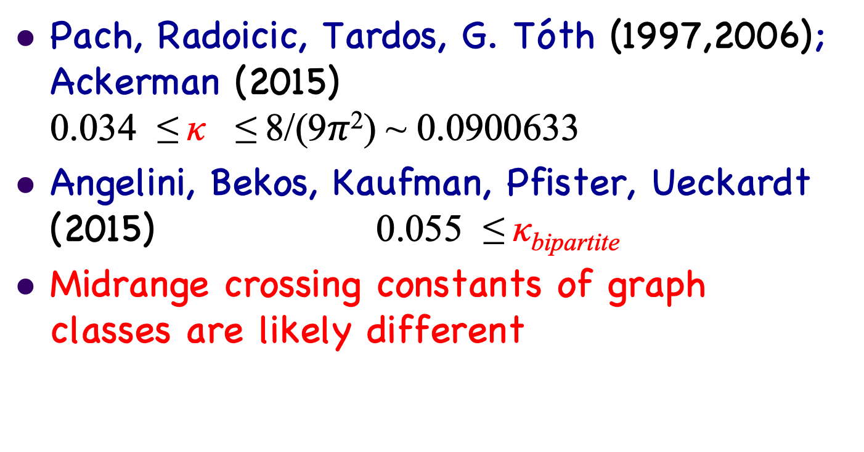
Value of midrange crossing constant
Pach, Radoicic, Tardos, G. Tóth (1997,2006); Ackerman (2015) 0.034 ≤ κ ≤ 8/(9$π$²) ~ 0.0900633
Angelini, Bekos, Kaufman, Pfister, Ueckardt (2015) 0.055 ≤ κ_{bipartite}
Midrange crossing constants of graph classes are likely different

Slide 28
Pach-Tóth construction
Move points of the square grid into general position by tiny moves
Join pairs of points with distance <d in straight line segments
Rectilinear drawing
No details available
Mimicks uniform distribution

Slide 29
Spheric version of the Pach-Tóth construction [Czabarka, Singgih, Sz, Zhiyu Wang]
Take n points on the sphere, iid uniformly
Join pairs on the shorter arc of great circle, if angle <d
I.e. join points to points
in the spherical cap of
polar angle d centered
at the first point

Slide 30
Calculations

Slide 31
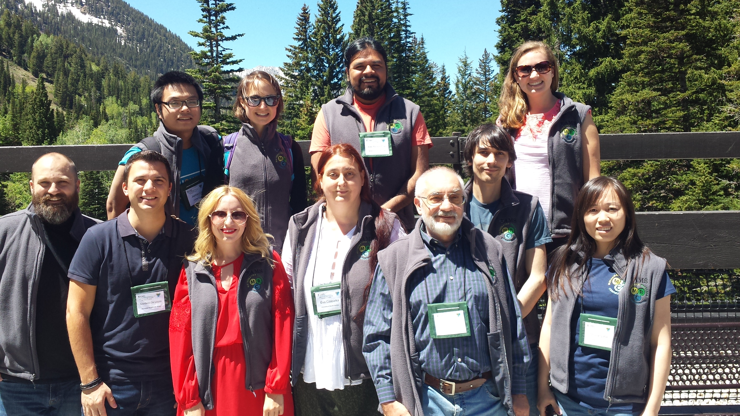
MRC Crossing Numbers: Beyond Planarity Workshop

Slide 32
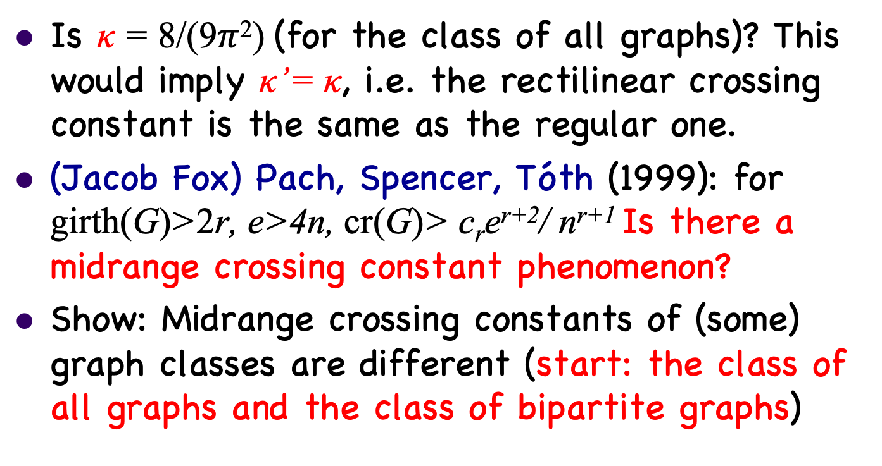
Open problems
Is κ = 8/(9$π$²) (for the class of all graphs)? This would imply κ’= κ, i.e. the rectilinear crossing constant is the same as the regular one.
(Jacob Fox) Pach, Spencer, Tóth (1999): for girth(G)>2r, e>4n, cr(G)> c_{r}e^{r+2}/ n^{r+1} Is there a midrange crossing constant phenomenon?
Show: Midrange crossing constants of (some) graph classes are different (start: the class of all graphs and the class of bipartite graphs)

Slide 33

Supported by NSF DMS 1600811 and (through the
American Mathematical Society) NSF DMS 1641020

