Slide 1
Newcomb’s paradox and spacetime
Mark Hogarth
Cambridge University

Slide 2
Talk in three parts
Newcomb’s paradox
Spacetime: predictable spacetimes and time-travel
Newcomb’s P revisited

Slide 3
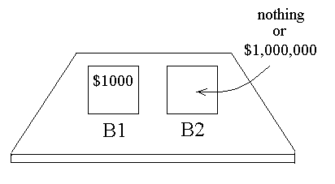
Newcomb’s P
You decide whether to take just B2, or B1 and B2
The Predictor knows in advance what you will actually choose.
If Predictor knows you’ll take just box B2, then She puts $1M in B2
If Predictor knows you’ll take both boxes, then she puts nothing in B2

Slide 4
So one box or both?

Slide 5
Three kinds of world might accommodate this story:
One with a God
Time-travel
‘Predictable spacetimes’

Slide 6
Predictable spacetimes
Idea: for an event to be predictable the event must be determined by some past data and that data must be available before the event has occurred.
So we require determinism to hold.
Note: predictability not equal to determinism, despite Laplace and Popper.

Slide 7
I could talk about Newtonian spacetime, but it’s not worth it (even determinism fails!).
So ‘spacetimes’ here = relativistic spacetimes. Here determinism has a chance. (I’ll use the standard causal structure notation.)

Slide 8
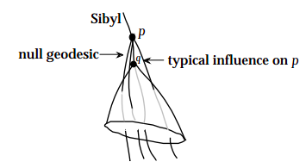
The general idea

Slide 9
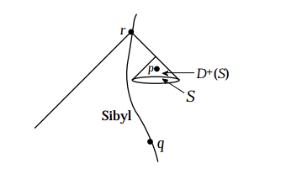
Fail

Slide 10
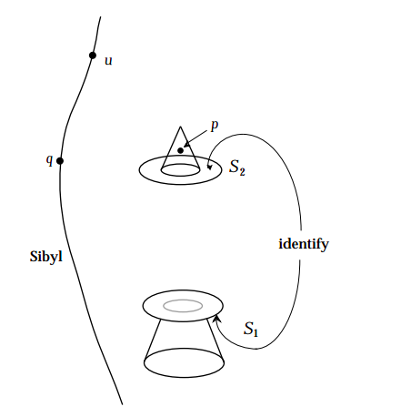
Win

Slide 11
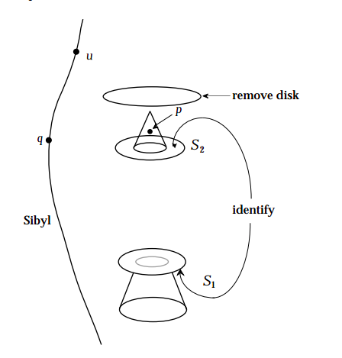
Partial win

Slide 12
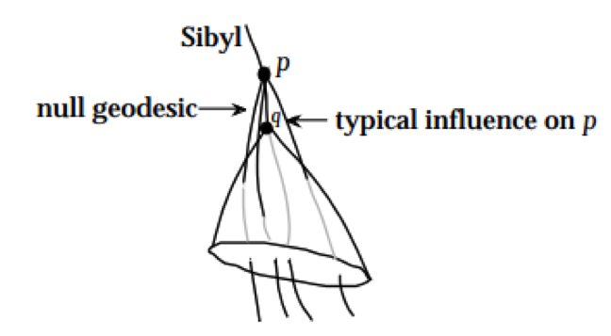
The domain of prediction of a point q, P(q), is the set of points p such that
(i) every past endless causal curve through p intersects J¯(q);
(ii) q∈I¯(p)

Slide 13
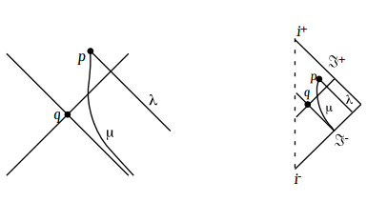
Mink: P(q)=∅

Slide 14
Predictable implies closed?

Slide 15
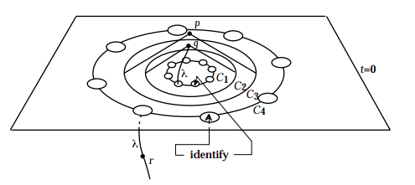
Nope

Slide 16
What about spacetimes that are ‘everywhere predictable’ (cylindrical spacetime)
EP1. each event is predictable from some event
EP2. the entire future is predicable from any event
EP2 implies EP1, obviously. But EP1 implies EP2!

Slide 17
We know
EP spacetimes have a Cauchy surface S, and S lies to the past of some point.
One can prove that a Cauchy surface to the past of some point must be compact.

Slide 18
But a compact Cauchy to the past of some point does not imply PE.
The closed FRW model is not PE

Slide 19
Footnotes on predictable spacetime: 1
One hears that ‘singularities spoil prediction’.
‘A singularity represents the ultimate unknowable in science. It is an edge or boundary of spacetime at which matter and influences can enter or leave the physical universe in a totally unpredictable fashion.’ (Paul Davies)

Slide 20
Not true.
Actually this is true: a single predictable event will usually be accompanied by a singularity.

Slide 21
Why?
Hawking and Penrose (1970):
A spacetime which satisfies the following cannot be timelike or null geodesically complete:
(a) there are no closed timelike curves;
(b) close-by timelike and null geodesics have a tendency to draw closer;
(c) every geodesic encounters some curvature, however small;
(d) there is a compact slice

Slide 22
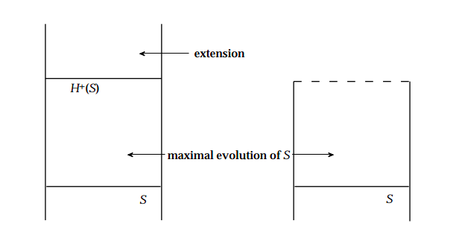
Footnote 2
So far assumed that spacetime itself is a given. But spacetime is dynamic. This creates a new obstacle for prediction.

Slide 23
Do predictable spacetimes beget paradox?
“Sybil predicts the light switch will be off. Just before she reaches the predicted event, she switches the light on.”

Slide 24
Part 2: Time-travel
Time-travel into the past, I mean, with unbroken worldlines, so not Doctor Who.
Time-travel in this sense is impossible in Newtonian spacetime and Minkowski spacetime.

Slide 25
Easy to construct toy models: toilet roll, wormhole, etc.

Slide 26
Famously there are solutions to EFEs which possess CTCs (closed timelike curves), e.g. Gödel spacetime, Taub-NUT, certain of the Kerr ‘black hole’ solutions

Slide 27
Do CTC spacetimes beget paradox?
The grandfather paradox
The gun paradox
The burning match

Slide 28
Resolution: gf and gun paradox show only that scenarios like this cannot ‘fit’ into worlds with CTCs.
They highlight fact that fields in CTCs are massively constrained (must ‘evolve back to original state’)

Slide 29
This is not odd. A story is only a story if it’s in a spacetime that can accommodate it.
Spatial analogy: an elephant will not fit into a mouse-sized universe.

Slide 30
Back predictable event paradox.
Resolution is the same: the spacetime cannot accommodate ‘stories’ like this. So actually fields in predicable spacetimes would also be massively constrained if the prediction were possible.

Slide 31
Back to Newcomb’s paradox
Suppose the predictor has access to time-travel. The predictor has already ‘seen’ the chooser open two boxes. In accordance with the story, the second box is empty. Outwitting the predictor is impossible.

Slide 32
It is akin to a time-traveller saying:
Event p in my past is ON. The event p is in my future too so I will arrange for p to OFF.
What this really shows is these ‘influencers’ are not possible in these environments; they don’t fit.

Slide 33
It helps to remove humans from the story. Replace with machines.
There is no device that could pass through event p and register it was OFF and then implement a procedure so that ‘later’ it was ON.

Slide 34
Discussions on Newcomb’s paradox are usually phrased in terms of ‘what is the rational decision to make?’
My conclusion is that rational influencers (or any device that could ‘outwit’ the Predictor) are simply not compatible with these strange worlds.

