Slide 1
Relation between solvability of some multivariate interpolation problems and the variety of subspace arrangement.
The subspace arrangement is
$𝓗$=$\bigcup_{j=1}^{m}{H_{j}}$
where $H_{j}$ are linear subspaces of ${ℂ }^{d}$.
$H_{j}$=$\bigcap_{k=1}^{s}{\{\left(z_{1},…,z_{d}\right):\sum_{i=1}^{d}{c_{i}z_{i}=0\}, \dim{H_{j}=d−s} }}$
$𝓗 ⊆{ℂ }^{d}\text{is} \text{an} \text{affine} \text{variety}{\dim{𝓗=max⁡\{dim}H}_{j}$}=d-s
Algebraic geometry studies the property $𝓗$

Slide 2
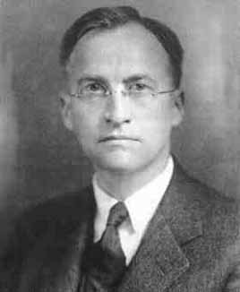
George David Birkhoff
Birkhoff Interpolation
(in one variable)
Birkhoff interpolation is an extension of Hermite interpolation.
It involves matching of values and derivatives of a function at certain points without the requirement that the derivatives are consecutive.
Example: find a polynomial $f\left(x\right)=c_{0}+c_{1}x+c_{2}x^{2}+c_{3}x^{3}:$
$$f\left(z_{1}\right)=a_{1},$$
$$f^{′}(z_{1})=a_{2},$$
$$f′\left(z_{2}\right)=a_{3}$$
$$f′′′\left(z_{2}\right)=a_{4}$$
If this equations have unique solution for all distinct $z_{1},z_{2}∈𝕜$ and all $a_{1},a_{2},a_{3},a_{4}∈𝕜$ the problem (${\text{𝓟}}_{3},\left\{0,1\right\},\{1,3\})$ is regular.
det $\left(\begin{matrix}1 & 0 & 0 & 0 \\ z_{1} & 1 & 1 & 0 \\ {z_{1}}^{2} & 2z_{1} & 2z_{2} & 0 \\ {z_{1}}^{3} & 3{z_{1}}^{2} & 3{z_{2}}^{2} & 3\end{matrix}\right)$
=𝞅($z_{1}$, $z_{2}$)
$${=6z}_{2}−6z_{1}$$
?
$𝒵\left(φ\right):=\{(z_{1}\text{, }z_{2}$) :𝞅($z_{1}$, $z_{2}$)}
$$⊆𝓗= \{(z_{1}\text{, }z_{2}\text{) :}z_{1}\text{=}z_{2}\text{)\}}$$

Slide 3
Example: find a polynomial $f\left(x\right)=c_{0}+c_{1}x+c_{2}x^{2}+c_{3}x^{3}$
$$f\left(z_{1}\right)=a_{1},$$
$$f^{′}′(z_{1})=a_{2},$$
$f′\left(z_{2}\right)=a_{3}$,
$$f′′′\left(z_{2}\right)=a_{4}$$
det $\left(\begin{matrix}1 & 0 & 0 & 0 \\ z_{1} & 1 & 0 & 0 \\ {z_{1}}^{2} & 2z_{2} & 2 & 0 \\ {z_{1}}^{3} & 3{z_{2}}^{2} & 6z_{1} & 6\end{matrix}\right)$
$$\text{=}\text{φ}\text{(}z_{1}\text{, }z_{2}\text{)}\text{ =12}$$
the problem (${\text{𝓟}}_{3},\left\{0,2\right\},\{1,3\})$ is regular, completely regular.
$𝒵\left(φ\right):=\{(z_{1}\text{, }z_{2}$) :𝞅($z_{1}$, $z_{2}$)=0}=$∅$ $⊆𝒵\left(z_{1}\text{−} z_{2}\right)=\{(z_{1}\text{, }z_{2}\text{) :}z_{1}\text{=}z_{2}\text{)\}}$
$\left\{0,2\right\}\bigcap{ \{1,3\})}$= $∅ and \left\{0,2\right\}∪\{1,3\text{\}}\text{=}\text{\{0,1,2,3,\}}$

Slide 4
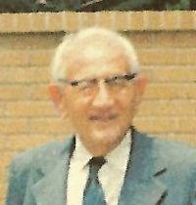
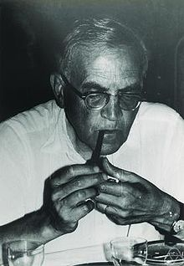
Birkhoff Interpolation problem:
${\text{(}\text{𝓟}}_{n}$,$M_{1},…M_{k}),M_{j}$ $⊆\{0,…,n+1\}$ where
$M_{j}$ $⊆\{0,…,n+1\}$; $\sum_{1}^{k}{\#M_{j}=n+1=dim}{\text{𝓟}}_{n}$ is regular if for any set of k district points $\{z_{1},…,$ $z_{k}\}⊆𝕜 the interpolation problem$ and any f$∈$ $\text{𝓟}$ there exists unique p$∈{\text{𝓟}}_{n}$ such that $f^{(k)}(z_{j}$)=$p^{(k)}(z_{j}$) for all k$∈M_{j}$ and all j=1,…,k.
George Pólya
Isaac Schoenberg
The problem ${\text{(}\text{𝓟}}_{n}$,$M_{1},…M_{k}),M_{j}$ $⊆\left\{0,…,n+1\right\}$ is regular if
k=n+1, $M_{j}$={0}, Lagrange interpolation
For k>0, k$∈M_{j}\overset{⇒}{}(k−1)$ $∈M_{j}$, Hermite interpolation
$M_{j}⋂M_{s}=∅$, ( $∪M_{j}$= $\{0,…,n+1\}$ ).
$${ℂ }^{d},d>1$$

Slide 5
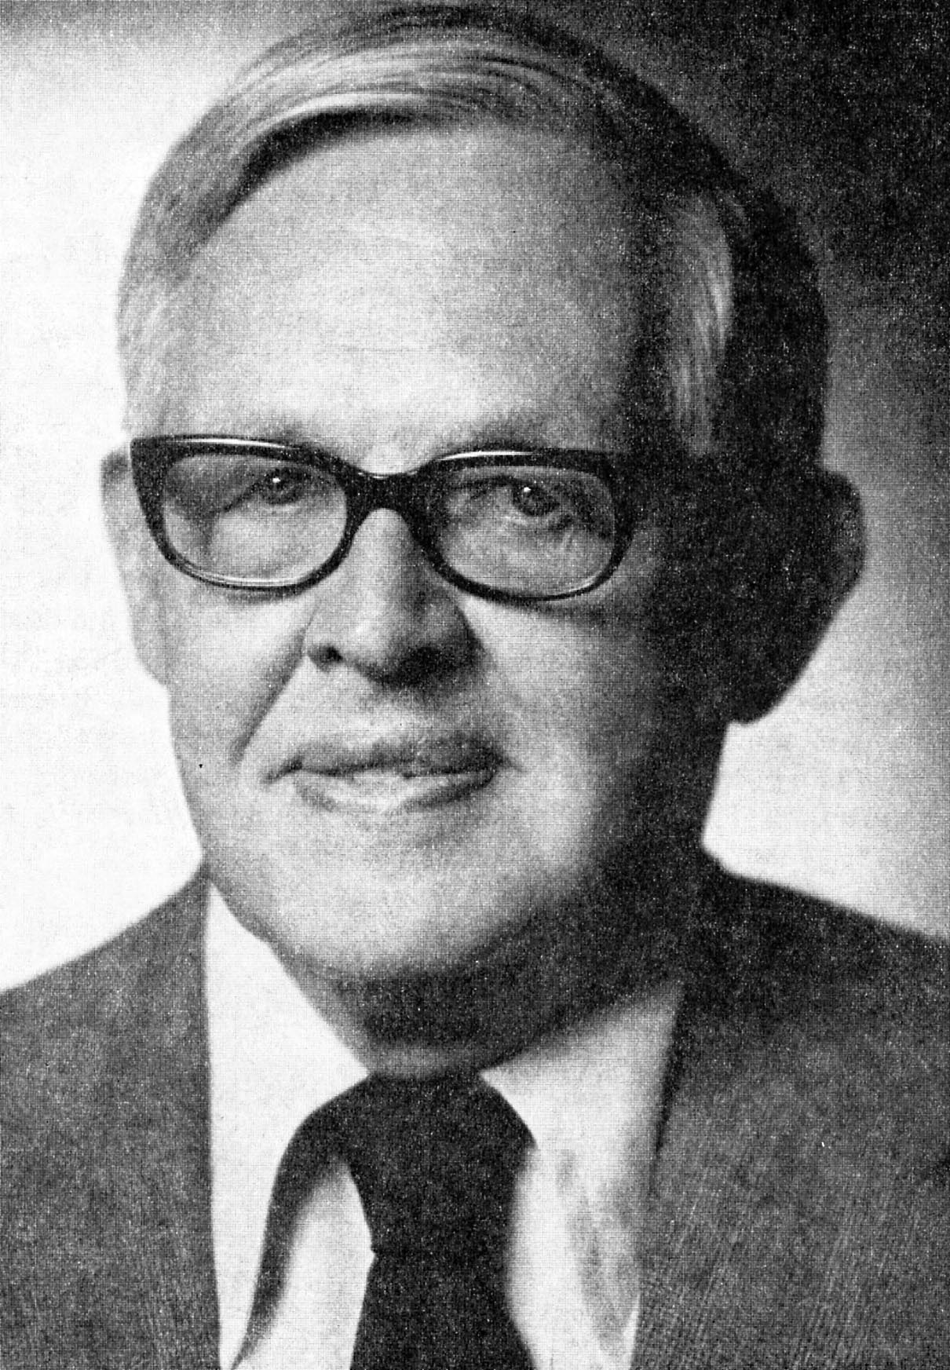
$\text{Take}\text{ (}\text{𝓟}\text{=}\text{span}\text{\{1,}\text{x}\text{,}\text{y}\text{,}\text{xy}\text{\}, }M_{1},$ $M_{2}), M_{1}, M_{2}⊆\left\{0,1\right\}×\left\{0,1\right\}$
$$and evaluate the corresponding determinant at two points:$$
$z_{1}$=($z_{1,1}$, $z_{1,2}),$ $z_{2}$=($z_{2,1}$, $z_{2,2}):$
$det=$ 𝞅($z_{1}$, $z_{2}$)= $x_{1}$=𝞅($z_{1,1}$, $z_{1,2},$ $z_{2,1}$, $z_{2,2}$) $∈ℂ\text{[}z_{1,1}\text{, }z_{1,2}, z_{2,1}\text{, }z_{2,2}\text{]}\text{, }$
$𝒵\left(φ\right)$ $⊆ℂ^{4}$; dim $𝒵\left(φ\right)$=3 if 𝞅$≠const.$
$𝓗=\{\left(z_{1,1}\text{, }z_{1,2}, z_{2,1}\text{, }z_{2,2}\right)$: $z_{1}\text{=} z_{2}, i.e.,$ $z_{1,1}\text{=} z_{2,1}, z_{1,2}\text{=} z_{2,2}$}
dim $𝓗$=2
If the scheme is regular then
$𝒵\left(φ\right)$ $⊆𝓗⇒dim𝒵\left(φ\right) ≤dim𝓗$
George G. Lorentz
If 𝞅$≠const. ⇒ dim$ $𝒵\left(φ\right)$=3$≤dim𝓗=2$
If 𝞅$=const. ≠0⇒scheme is completely regular$
${If M}_{1}⋂M_{2}≠∅$ and $z_{1}\text{=} z_{2}$ then the determinant $φ$ contains two identical rows (columns), hence $M_{1}⋂M_{2}=∅$
The same is true in real case

Slide 6
Birkhoff Interpolation (in several variables)
Carl de Boor
Given a subspace $\text{𝓟}⊆𝕜\text{[}x_{1},…, x_{d}\text{]}\text{, }$a collection of subspaces $Q_{1},…,$ $Q_{k}$ $⊆$ $\text{𝓟}$, a set of points $z_{1},…,$ $z_{k}∈𝕜^{d}$ and a function f $∈𝕜\text{[}x_{1},…,x_{d}$] we want to find a polynomial p $∈$ $\text{𝓟}$ such that
$\overline{q}$($D_{1},…,D_{d}$)f($z_{j}$)= $\overline{q}$($D_{1},…,D_{d}$)f($z_{j}$)
for all q$∈Q_{j}.$
The scheme ($\text{𝓟}$,$Q_{1},…Q_{k})$ is regular if the problem has a unique solutions for all f $∈𝕜\text{[}x_{1},…,x_{d}$] and all distinct $z_{1},…,$ $z_{k}∈𝕜^{d}$, it is completely regular if it has unique solution for all $z_{1},…,$ $z_{k}∈𝕜^{d}$.
Amos Ron

Slide 7
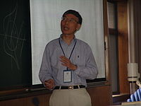
Birkhoff Interpolation (in several variables)
$det=$ 𝞅($z_{1}$,…, $z_{k}$) is a polynomial in $d×k variables$
$𝓗$=$\bigcup_{i≠j}{H_{i,j};H_{i,j}=\left\{{(z}_{1}\text{,}…, z_{k}\right)∈ℂ^{kd}:z_{i}=z_{j}\}}$
dim $𝓗$=max{dim$H_{i,j}$}=kd-d
$regularity means 𝒵\left(φ\right)$ $⊆𝓗$
If 𝞅$≠const. ⇒ dim$ $𝒵\left(φ\right)$=dk-1$≤kd−d$= $dim𝓗$
Theorem: If ($\text{𝓟}$,$Q_{1},…Q_{k})$ is regular then $Q_{i}{∩Q}_{j}=\{0\}$
Conjecture: it is true in the real case
False
Rong-Qing Jia
A. Sharma

Slide 8
Haar subspaces and Haar coverings
Alfréd Haar
Definition: H=span { $h_{1},…,h_{n}\} if for any distinct points$
$\{z_{1},…,$ $z_{n}\}⊆𝕜^{d}$
the determinant $det\left(h_{i}(z_{j})\right)≠0$
(The Lagrange interpolation problem is well posed)
${\text{𝓟}}_{n−1} is a Haar subspace of 𝕜\left[x\right] and the unique Haar suspace in$ $ℂ$[x].
For d>1, n>1 there are no n-dimensional Haar subspaces in $𝕜\left[x_{1},…,x_{d}\right]$ or even in C($𝕜^{d}$)
J. C. Mairhuber in real case and I. Schoenberg in the complex case;.
or from the previous discussion: ($\text{𝓟}$,{0},{0},…,{0})

Slide 9
Definition: A family of n-dimensional subspaces {$H_{1},…,H_{s}\} in \text{C}\text{(}𝕜^{d}\text{)}$
$$is a Haar covering of{ 𝕜}^{d} if for any distinct points$$
$\{z_{1},…,$ $z_{n}\}⊆𝕜^{d}$
the Lagrange interpolation problem is well posed in one of these spaces.
$H_{k}$=span { ${h_{1}}^{(k)},…,{h_{n}}^{(k)}\}$
{$H_{1},…,H_{s}\}is a Haar covering of{ 𝕜}^{d} if for any distinct points$
$\{z_{1},…,$ $z_{n}\}⊆𝕜^{d} one of the determinants$
$${\text{Δ}}_{k}\left(z_{1},…, z_{n}\right)=det\left({h_{1}}^{(k)}(z_{j})\right)≠0$$
Question: What is the minimal number s:=${\text{η}}_{n}(𝕜^{d})$ of n-dimensional subspaces ${\{H}_{1},…,H_{s}\} in 𝕜\left[x_{1},…,x_{d}\right] that forms a Haar covering of{ 𝕜}^{d}$
$and what are those subspaces$?
Kyungyong Lee
Conjecture: : ${\text{η}}_{n}\left(ℂ^{2}\right)=n$

Slide 10
$$y$$
${\text{η}}_{2}\left(𝕜^{2}\right)=2$
$$H_{1}=span\left\{1,x\right\},H_{2}=span\left\{1,y\right\}$$
$$x$$
Theorem (Stefan Tohaneanu& B.S.): ${\text{η}}_{3}\left(ℂ^{2}\right)=3$
The three spaces
$H_{1}=span\left\{1,x,y\right\},H_{2}=span\left\{1,x,x^{2}\right\}$, $H_{3}=span\left\{1,y,y^{2}\right\} will do:$
It remains to show that no two subspaces can do the job.
$H_{1}$=span { ${h_{1}}^{(1)}, {h_{2}}^{(1)},{h_{3}}^{(1)}\} ;H_{2}\text{=}\text{span}\text{ \{ }{h_{1}}^{(2)}, {h_{2}}^{(2)},{h_{3}}^{(2)}\}$
I want show that there are three distinct points $z_{1},z_{2},$ $z_{3}=0 such that$
${{\text{Δ}}_{1}\left(z_{1}, z_{2},0\right)\text{=0, }\text{Δ}}_{2}\left(z_{1}, z_{2},0\right)$=0
${z_{1}=(z}_{1,1}, z_{1,2}$), ${z_{2}=(z}_{2,1}, z_{2,2}$),
$$𝓗≔\left\{\left(0,0,a,b\right)\right\}∪\{(a,b,0,0)∪ \{(a,b,a,b)\}$$

Slide 11
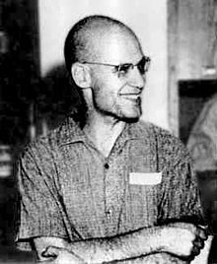
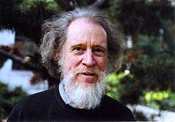
$𝒵\left({\text{Δ}}_{1},{\text{Δ}}_{2}\right)$={($z_{1,1}, z_{1,2},z_{2,1}, z_{2,2}$): ${\text{Δ}}_{1}=0 and {\text{Δ}}_{2}$=0}
$𝒵\left({\text{Δ}}_{1},{\text{Δ}}_{2}\right)$ $⊆ℂ^{4}$
$$𝓗≔\left\{\left(0,0,a,b\right)\right\}∪\{(a,b,0,0)∪ \{(a,b,a,b)\}$$
(0,0,0,0)
(0,0,1,1)
$$𝓗$$
$$𝒵\left({\text{Δ}}_{1},{\text{Δ}}_{2}\right)=𝓗 ?$$
dim $𝒵\left({\text{Δ}}_{1},{\text{Δ}}_{2}\right)$=2=dim $𝓗$
(-1,-1,0,0)
Not every two-dimensional variety in $ℂ^{4}$ can be formed as a set of common zeroes of two polynomials. The ones that can are called (set theoretic) complete intersections.
As luck would have it, $𝓗$ is not a complete intersection:
$𝓗\backslash (0,0,0,0)$ is not connected…
Alexander Grothendieck
Robin Hartshorne
A very deep theorem states that a two dimensional complete intersection in $ℂ^{4}$ can not be disconnected by removing just one point

Slide 12
${\text{(}\text{Tom} \text{McKinley} \text{and} \text{B}\text{.}\text{S}\text{.): }\text{η}}_{3}(𝕜^{2})$=3
${\text{η}}_{4}(𝕜^{2})≤4$
${\text{d}≤\text{η}}_{n}\left(𝕜^{d}\right)<∞$
$H_{1}=span\left\{1,x,y\right\},H_{2}=span\left\{1,x,x^{2}\right\}$, $H_{3}=span\left\{1,y,y^{2}\right\}$
The family of D-invariant subspaces spanned by monomials form a finite Haar covering.
There are too many of them: for n=4 in 2 dimensions there are five:
$$\begin{matrix} & & & & \\ & & & & \\ & & & & \\ & & & & \\ 1 & x & x^{2} & x^{3} & \end{matrix}$$
$$\begin{matrix} & & & & \\ & & & & \\ & & & & \\ y & & & & \\ 1 & x & x^{2} & & \end{matrix}$$
$$\begin{matrix} & & & & \\ & & & & \\ & & & & \\ y & xy & & & \\ 1 & x & & & \end{matrix}$$
$$\begin{matrix} & & & & \\ & & & & \\ y^{2} & & & & \\ y & & & & \\ 1 & x & & & \end{matrix}$$
$$\begin{matrix} & & & & \\ y^{3} & & & & \\ y^{2} & & & & \\ y & & & & \\ 1 & & & & \end{matrix}$$
Yang tableaux
${\text{Cojecture}\text{: }\text{η}}_{n}(𝕜^{d})$=$\left(\begin{matrix}n+d−2 \\ n−1\end{matrix}\right)$

Slide 13
köszönöm
Thank You
Thank You
köszönöm

