Slide 1
Biased Positional Games and the Erdős Paradigm
Michael Krivelevich
Tel Aviv University

Slide 2
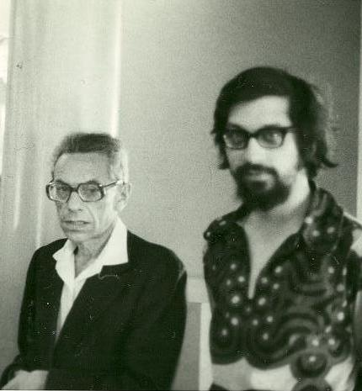
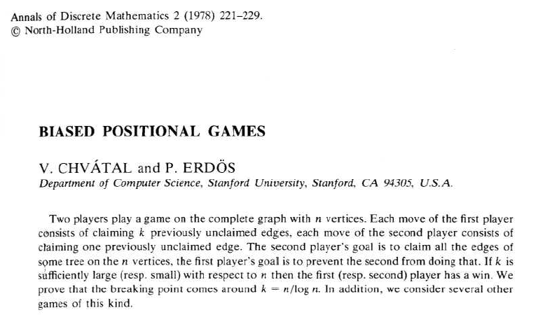
It all started with Erdős – as usually…
This time with Chvátal:

Slide 3
Unbiased Maker-Breaker games on complete graphs
Formally defined (including players’ names) by Chvátal and Erdős
Board = $E\left(K_{n}\right), n→∞$
Two players: Maker, Breaker, alternately claiming one free edge of $K_{n}$
- till all edges of $K_{n}$ have been claimed
Maker wins if in the end his graph M has a given graph property P
(Hamiltonicity, connectivity, containment of a copy of H, etc.)
Breaker wins otherwise, no draw
Say, Maker starts
unbiased

Slide 4
It is (frequently) all too easy for Maker…
Ex.: Hamiltonicity game
Maker wins if creates a Hamilton cycle
CE: Maker wins, very fast - in ≤ 2n moves
(…, Hefetz, Stich’09: Makers wins in n+1 moves, optimal)
Ex.: Non-planarity game
Maker wins if creates a non-planar graph
just wait for it to come
( but grab an edge occasionally…)
- after 3n-5 rounds Maker, doing anything, has a non-planar graph…

Slide 5
Tools of the trade
Erdős-Selfridge criterion for Breaker’s win:
Th. (ES’73): H – hypergraph of winning configurations (=game hypergr.)
(Ex: Ham’ty game: H = Ham. cycles in $K_{n}$)
If:
$\sum_{A∈H}{2^{−|A|}}<\frac{1}{2}$ ,
Then Breaker wins the unbiased M-B game on H
Derandomizing the random coloring argument
First instance of derandomization
(conditional expectation method)

Slide 6
Biased Maker-Breaker games
CE: Idea: give Breaker more power, to even out the odds
Now: Maker still claims 1 edge per move
Breaker claims $b=b(n)$ edges per move
Ex.: biased Hamiltonicity game
$b$=1 – Maker wins (CE’78)
$b$=$n$-1 – Breaker wins (isolating a vertex in his first move)
Idea: vary $b=b(n)$, see who is the winner.
Q. (CE): Does there exist $b=b(n)→∞$ s.t.
Maker still wins (1:$b$) Ham’ty game on $K_{n}$?
More generally, m edges per move

Slide 7
Biased Erdős-Selfridge
Th. (Beck’82): H – game hypergraph
If:
$\sum_{A∈H}{{(1+b)}^{−|A|/m}}<\frac{1}{1+b}$ ,
Then Breaker wins the ($m$:$b$) M-B game on H
$m$=$b$=1 – back to Erdős-Selfridge

Slide 8
Bias monotonicity, critical bias
Prop.: Maker wins 1:b game
⇒ Maker wins 1:(b-1)-game
Proof: S_{b} := winning strategy for M in 1:b
When playing 1:(b-1) : use S_{b}; each time assign a fictitious
b-th element to Breaker. ■
$b^{∗}=b^{∗}\left(n\right)=$ min{b: Breaker wins (1:b) game} – critical bias
Critical point: game changes hands
M
M
M
M
M
B
B
B
winner
1
2
3
b*
bias

Slide 9
So what is the critical bias for…?
positive min. degree game: Maker wins if in the end $δ(M)≥1$?
connectivity game: ---------||---------||--------- has a spanning tree?
Hamiltonicity game: ---------||---------||--------- a Hamilton cycle?
non-planarity game: ---------||---------||--------- a non-planar graph?
H-game: ---------||---------||--------- a copy of H?
Etc.
Most important meta-question in positional games.

Slide 10
Probabilistic intuition/Erdős paradigm
What if…?
Instead of clever Maker vs clever Breaker
random Maker vs random Breaker
(Maker claims 1 free edge at random,
Breaker claims b free edges at random)
In the end: Maker’s graph = random graph G(n,m)
$m=\left\lceil \frac{\left(\begin{matrix}n \\ 2\end{matrix}\right)}{b+1}\right\rceil$

Slide 11
Probabilistic intuition/Erdős paradigm (cont.)
For a target property P (=Ham’ty, appearance of H, etc.)
Look at $m^{∗}=min⁡\{m:G\left(n,m\right)$ has P with high prob. (whp)
Then guess:
$m^{∗}=\left\lceil \frac{\left(\begin{matrix}n \\ 2\end{matrix}\right)}{b^{∗}+1}\right\rceil$ ⇒ $b^{∗}≈\frac{\left(\begin{matrix}n \\ 2\end{matrix}\right)}{m^{∗}}$
- Bridging between positional games and random graphs

Slide 12
Sample results for G(n,m)
and what would follow from them for games
thru the Erdős paradigm:
positive min. degree: $m^{∗}=\left(\frac{1}{2}+o(1)\right)nlnn$
connectivity: $m^{∗}=\left(\frac{1}{2}+o(1)\right)nlnn$ (Erdős, Rényi’59)
Hamiltonicity: $m^{∗}=\left(\frac{1}{2}+o(1)\right)nlnn$ (Komlós, Szemerédi’83; Bollobás’84)
can expect: critical bias for all these games:
$$b^{∗}≈\frac{\left(\begin{matrix}n \\ 2\end{matrix}\right)}{m^{∗}}=(1+o\left(1\right))\frac{n}{\ln{n} }$$

Slide 13
Breaker’s side
Chvátal-Erdős again:
Th. (CE’78): M-B, (1:b), $E\left(K_{n}\right)$
$b=\frac{\left(1+ε\right)n}{\ln{n}}$ ⇒ Breaker has a strategy to isolate a vertex in Maker’s graph
⇒ wins: - positive min. degree;
- connectivity;
- Hamiltonicity;
- etc.
Key tool: Box Game (=M-B game on H; edges of H are pairwise disjoint)

Slide 14
It works!
Results for biased positional games:
min. degree game
Th. (Gebauer, Szabó’09): $b=\frac{\left(1−ε\right)n}{\ln{n}}$
⇒ Maker has a winning strategy
Connectivity game
Th. (Gebauer, Szabó’09): $b=\frac{\left(1−ε\right)n}{\ln{n}}$
⇒ Maker has a winning strategy
Proof idea: potential function + Maker plays as himself

Slide 15
It works! (cont.)
Results for biased positional games (cont.):
Hamiltonicity game
Th. (K’11): $b=\frac{\left(1−ε\right)n}{\ln{n}}$
⇒ Maker has a winning strategy
Proof idea: Pósa’s extension-rotation, expanders, boosters, random strategy for positive degree game.
Conclusion: for all these games, critical bias is:
$$b^{∗}=(1+o\left(1\right))\frac{n}{\ln{n} }$$
- in full agreement with the Erdős paradigm!

Slide 16
It works! (kind of…)
Planarity game
M-B, (1:b), on $E\left(K_{n}\right)$
Maker wins if in the end his graph is non-planar
Th.: $b^{∗}=(1+o\left(1\right))\frac{n}{2 }$
Upper bound – Bednarska, Pikhurko’05
Lower bound – Hefetz, K., Stojaković, Szabó’08
In random graphs G(n,m):
- critical value for non-planarity: $m^{∗}=\left(\frac{1}{2}+o(1)\right)n$
(Erdős, Rényi’60; Łuczak, Wierman’89)
would expect $b^{∗}≈\frac{\left(\begin{matrix}n \\ 2\end{matrix}\right)}{m^{∗}}=\left(1+o\left(1\right)\right)n$
– off by a constant factor…

Slide 17
It works! (sometimes…)
After all, it is just a paradigm…
Ex.: $H=K_{3}$ - triangle game
M-B, (1:$b)$, on $E\left(K_{n}\right)$
Maker wins if in the end his graph contains a triangle $K_{3}$
Th. (CE’78): $b^{∗}=Θ\left(\sqrt{n}\right)$
While: prob. intuition: $m^{∗}=Θ\left(n\right)$⇒ expect $b^{∗}=Θ\left(n\right)$
Still, there is a decent probabilistic explanation for the crit. bias

Slide 18
Positional games and Ramsey numbers
$$R\left(s,t\right)=min\left\{n: ∀G=\left(V,E\right), \left|V\right|=n, ω(G\right)≥s or α(G)≥t\}$$
Th. (Erdős’61): $R\left(3,t\right)≥\frac{ct^{2}}{\log^{2}t}$
Alternative proofs: Spencer’77 – Local Lemma;
K’95 – large deviation inequalities
Known: $R\left(3,t\right)=Θ\left(\frac{ct^{2}}{\log{t}}\right)$
Ajtai, Komlós, Szemerédi’80;
Kim’95

Slide 19
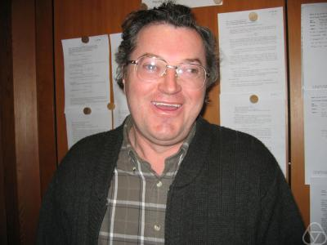
Positional games and Ramsey numbers (cont.)
Proof through positional games – Beck’02
Proof sketch: (1:b) game on $E\left(K_{n}\right)$, $b=c\sqrt{n}$
Red player: thinks of himself as Breaker in (1:b) triangle game
⇒ wins (CE’78) ⇒ no $K_{3}$ in Blue graph
Blue player: thinks of himself as Breaker in (b:1) $t$-clique game, $t=c\sqrt{n}\log{n}$
⇒ wins (thru generalized ES) ⇒ no $K_{t}$ in Red graph
Result: Red/Blue coloring of $E\left(K_{n}\right)$
no Blue $K_{3}$
no Red $K_{t}$. ■

