Slide 1
A sharp threshold for Ramsey properties of random sets of integers
(A Socratic dialogue)
Ehud Friedgut, Weizmann Institute
Joint work with Hiệp Hàn, Yuri Person,
and Mathias Schacht

Slide 2
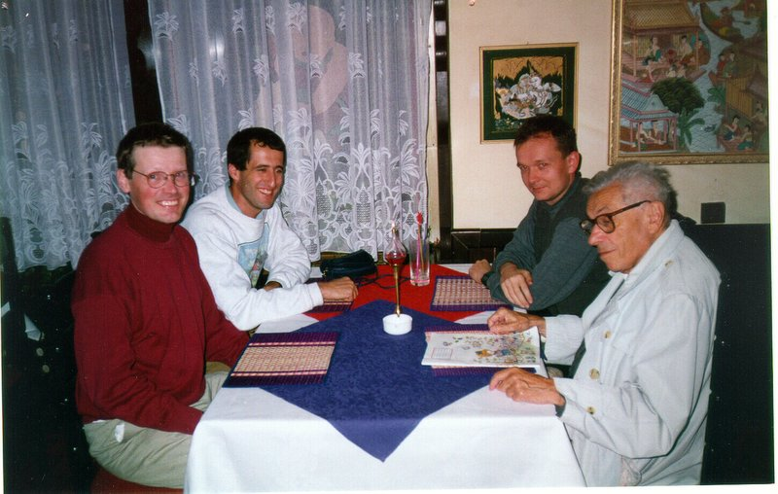

Slide 3

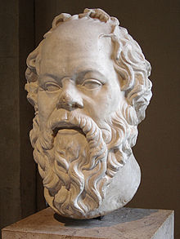
: Hello, I’m Socrates, I’m 2483 years old
: And I thought I was old...Pleased to meet you, Paul Erdos, 100 years old.
: I was looking at the title of this talk. Would you oblige me by explaining what a sharp threshold is?
: With pleasure.

Slide 4
: So, consider the random graph G(n,p). It becomes connected when p is approximately log(n)/n. Yet the increase from, say, 1% probability to 99%, happens for p in an interval with length of order only 1/n.
: Sharp, indeed. Can you give me an example of a non-sharp threshold?

Slide 5
: Sure. Consider the property of containing a triangle. There the critical probability is of order 1/n, and the length of the threshold interval is also of order 1/n.
: Hmmm..., any other interesting examples?
: Actually, not really.

Slide 6
: ??
: You see, by a result of Friedgut from ’99...
: 99 B.C. or A.D. ?
: That’s 1999 A.D. Anyhow, he shows that whenever a graph property has a coarse threshold, it’s because of a “local reason”

Slide 7
: I see, so triangle=local=coarse, and connectivity=global=sharp?
: Correct!
: Let’s see. So, having chromatic number, say, greater than 3... Wait, is that global or local?
: In our context, it’s global.

Slide 8
: But, if there’s a K4 in the graph, that’s local, no?
: So true, my scholarly friend. Yet in the threshold setting, where p turns out to be of order 1/n, you’re not going to see any copies of K4.
: But how do you know there isn’t some other “local reason” for non-3-colorability?

Slide 9
: Well, it actually takes some work. Achlioptas and Friedgut showed this in 1999.
: Achlioptas? Sounds like a co-patriot of mine. Anyhow, I understand it can be tricky proving that a property is “non-local”.
: Indeed. For example, for the property of having choice number > 3, it’s not been proven.

Slide 10
: I noticed that you said that Friedgut’s result is about properties of random graphs. But the title of the talk mentioned random sets of integers.
: That’s an astute observation. There’s an analogous theorem of Bourgain which takes care of more general settings.
: Can you please explain about the case at hand?

Slide 11
: With pleasure. The question is when a random subset of {1,2,...,n} has the property that any coloring of its elements by two colors, say, blue and red, produces a monochromatic 3-term arithmetic progression.
: Wait, what density is critical for this property?

Slide 12

: Good question. Rödl and Ruciński proved that the critical density is which is when the expected number of elements and the expected number of 3-AP’s is approximately the same.
: Excuse me, Uncle Paul, can I interrupt for a moment?
: Please.

Slide 13
: I see. So now you want to decide whether the property we’re discussing could possibly be correlated with something “local”. How about containing an interval of twenty consecutive integers? It seems to me that would suffice to force a monochromatic 3-AP.
: True, but Rödl and Rucinski showed that all such obvious examples are like a K4 in G(n,c/n): highly unlikely. The problem is whether some more innocuous examples could, magically, be correlated with the Ramsey property.

Slide 14
: You know, I haven’t yet developed an intuition whether this is a difficult task.
: Well, for a similar problem in graphs, having a monochromatic triangle in every bi-coloring, it took Friedgut, Rödl, Ruciński and Tetali more than 100 pages.
: Great Zeus! Why so many?

Slide 15

: Well, 65 of these pages were devoted to developing and applying a sparse-hypergraph-regularity-lemma they needed.
: Ouch.
: Indeed, to quote a good friend of mine:
: “When possible, regularity must be avoided at all cost.”

Slide 16
: So, in the current work, was regularity side-stepped?
: Yes! Thanks to works of BMS and/or ST.
: ?
: Balogh-Morris-Samotij, and Saxton-Thomason.

Slide 17
: So, you claim that you can prove that this Ramsey property is not correlated with, say, containing three consecutive integers?
: That’s right.
: But how?
:O.k., I’ll try to sketch the argument.

Slide 18
: O.k. Consider a random subset of {1,2,...,n}, with density approximately . The property we’re discussing is whether every bi-coloring of the set contains a monochromatic 3-term AP. Now, we’re assuming by way of contradiction...
: What’s that?
: Reductio ad absurdum.
: Oh, so why not use simple Latin?

Slide 19
: Sorry, I’ll try to stick to plain terminology. So we assume by way of reductio ad absurdum that the Ramsey property has a non-sharp threshold. By Bourgain’s theorem, there’s a “local culprit”, say an interval of length 3, such that containing it is significantly correlated with the Ramsey property.

Slide 20
:Wait, do you mean a specific interval of length three, or any interval of length three?
: Excellent question!! To avoid this delicate point we will work in the cyclical group Zn, rather than in {1,2,...n}, so all intervals of length three are the same.

Slide 21
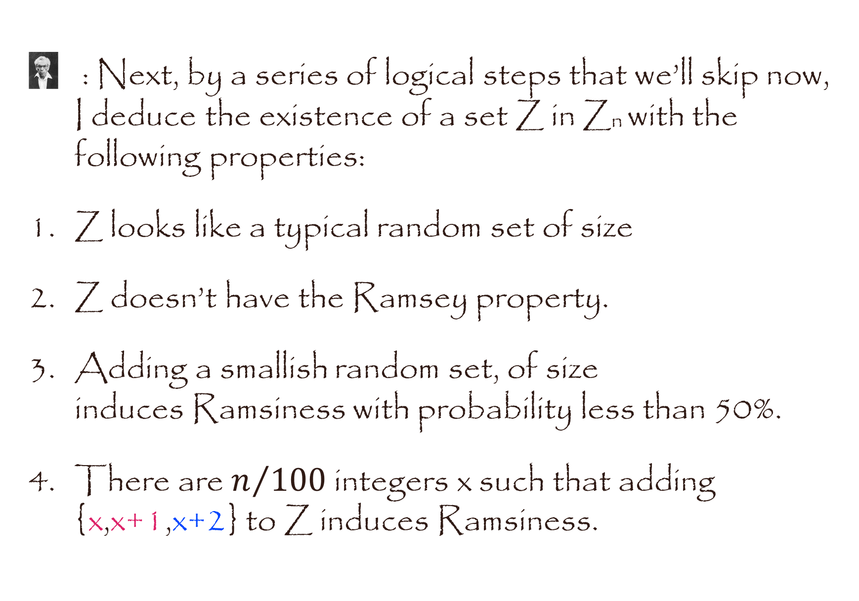
: Next, by a series of logical steps that we’ll skip now, I deduce the existence of a set Z in Zn with the following properties:
Z looks like a typical random set of size
Z doesn’t have the Ramsey property.
Adding a smallish random set, of size induces Ramsiness with probability less than 50%.
There are $n/{100 }$integers x such that adding {x,x+1,x+2} to Z induces Ramsiness.

Slide 22
: O.k., I think I follow so far. But how will this reduce to absurdum?
: We’ll see that the fact that for so many x’s, adding {x,x+1,x+2} induces Ramsiness, means that the set of colorings with no monochromatic 3-AP is rather restricted.
: and?...
That will imply that adding more points at random kills all possible colorings with probability close to 100%, and not 50% as we assumed.

Slide 23
: But it’s not even clear to me how adding {x,x+1,x+2} to Z can ruin all possible colorings. Is it because it forces x-1 to be colored blue?
: No, typically x-1 doesn’t even belong to Z. It’s more complicated. Here I think a picture might help.

Slide 24
a....b...c...x,x+1,x+2,..a’...b’...c’
: What this picture means is that there are elements a,b,c,a’,b’,c’ in Z such that in every proper coloring either [a and a’ are red] or [b and b’ are red] or [c and c’ are blue]
: But couldn’t the interaction of {x,x+1,x+2} with Z be of a different nature?

Slide 25
: Yes, it could, but using probabilistic arguments we can focus on one such prototype.
: How can an argument be “probabilistic”?
: Oh, that’s an idea that I introduced a mere 65 years ago.

Slide 26
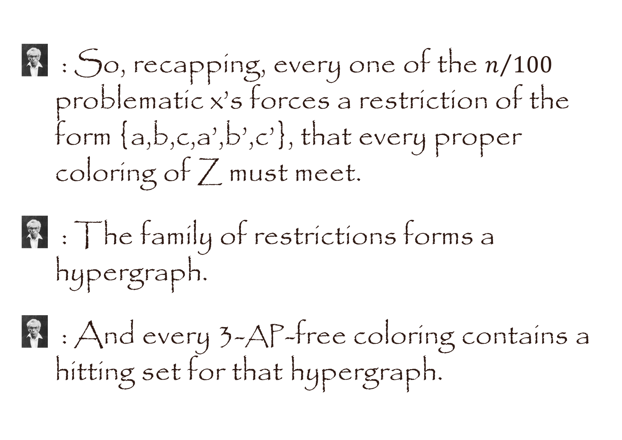
: So, recapping, every one of the $n/{100}$ problematic x’s forces a restriction of the form {a,b,c,a’,b’,c’}, that every proper coloring of Z must meet.
: The family of restrictions forms a hypergraph.
: And every 3-AP-free coloring contains a hitting set for that hypergraph.

Slide 27
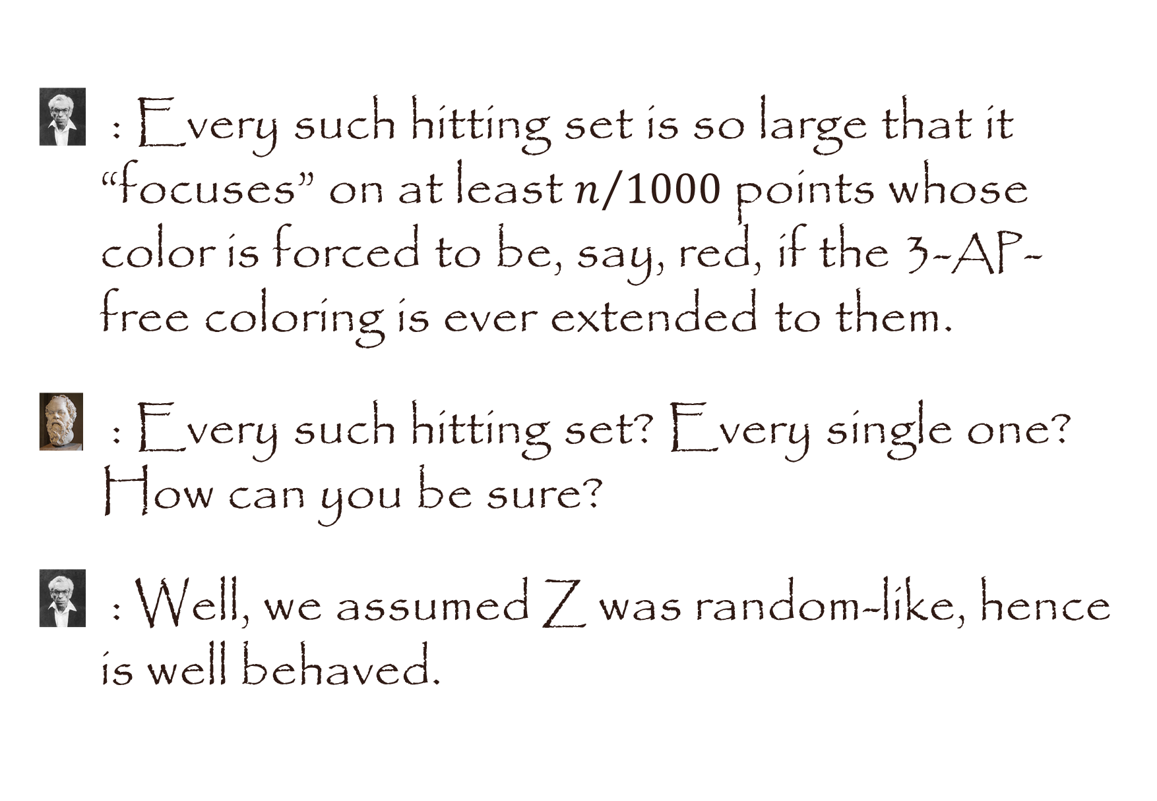
: Every such hitting set is so large that it “focuses” on at least $n/{1000}$ points whose color is forced to be, say, red, if the 3-AP-free coloring is ever extended to them.
: Every such hitting set? Every single one? How can you be sure?
: Well, we assumed Z was random-like, hence is well behaved.

Slide 28
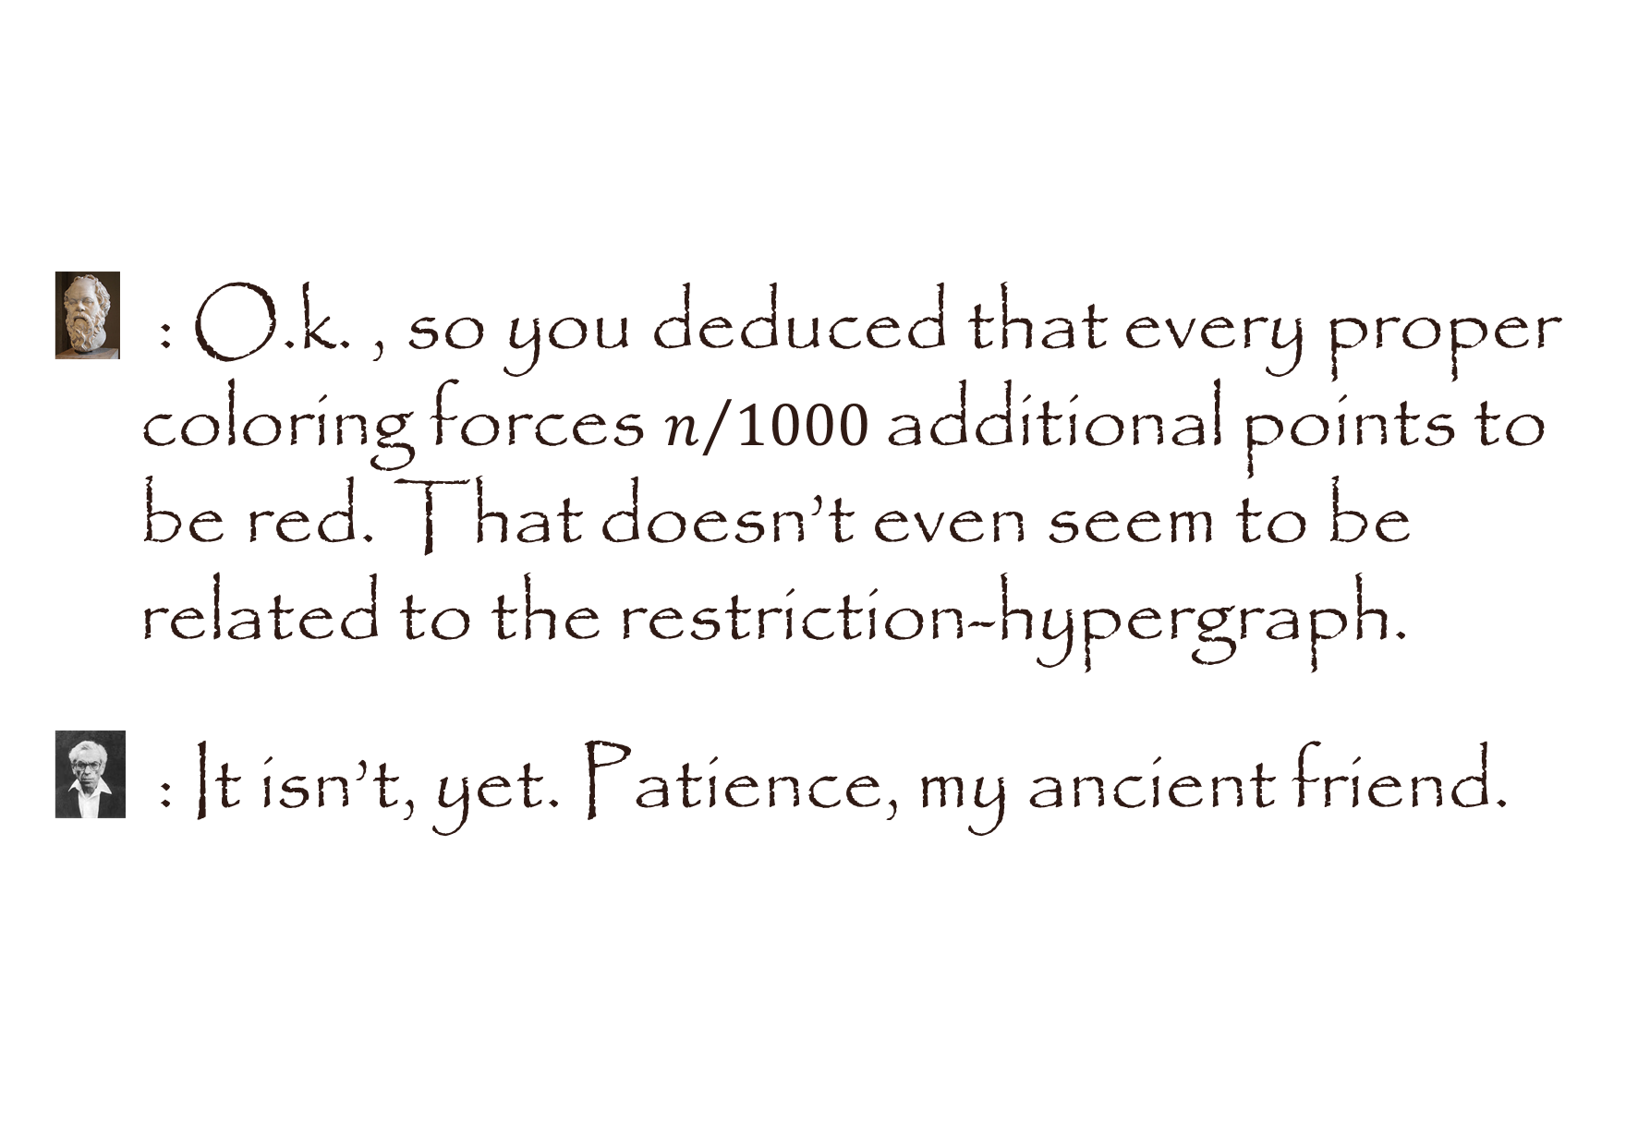
: O.k. , so you deduced that every proper coloring forces $n/{1000}$additional points to be red. That doesn’t even seem to be related to the restriction-hypergraph.
: It isn’t, yet. Patience, my ancient friend.

Slide 29
: So all these points whose color is forced to be red, do they contain very many 3-AP’s?
: How did you know?! It follows from a strong version of Szemeredi’s (or Roth’s) theorem.
: So if the random addition of more points contains one of these 3-APs you won’t be able to extend the 3-AP-free coloring?

Slide 30
: Right! You’ve got the drift of it.
: But consider the case where these additional points don’t contain any of these 3-AP’s?
: Aha! By Janson’s inequality that’s exponentially unlikely.
: I see. So every proper coloring of Z is exponentially unlikely to be extendable to a smallish random set of points. And that contradicts the fact that the random set induces Ramsiness with only 50% probability?

Slide 31
: Not so fast... Each coloring is exponentially unlikely to be extendable, but we have an exponential number of colorings.
: ανάθεμα! So how do we know who wins this race of exponents?
: We don’t. Here’s where BMS and/or ST come to the rescue.

Slide 32
: The number of hitting sets (that are exponentially unlikely to be extended) is exponential, but BMS/ST allows us to bunch them into a much smaller number of bunches, where hitting sets in the same bunch induce the same restriction.
: So then you can use a union bound!
: Ah, you learn so quickly. Such a sage!

Slide 33
: ...and that yields the contradiction? With so many supposed local restrictions, it’s extremely unlikely (much less than 50%) that any coloring of Z can be extended to additional random points ? So we have our contradiction!
: Quod Erat Demonstrandum. Or as you say, ὅπερ ἔδει δεῖξαι .

Slide 34
: Wow, that’s very nice. Does this proof extend to more general questions?
: Well, the same proof works for arithmetic progressions of length greater than 3, but unfortunately, not for more than two colors. Also, if you replace “arithmetic progression” by some other Rado-type equation, complications arise.

Slide 35
: O.k., you’re getting me giddy here.
: How can I repay your infinite patience and kindness in explaining all this to me?
: How about a lesson in philosophy?
: With pleasure. But be forewarned, philosophy can be very difficult, and our reasoning may be quite different from what you’re used to.
: Have no fear. My brain is open...

Slide 36

My brain is open...

