Slide 1
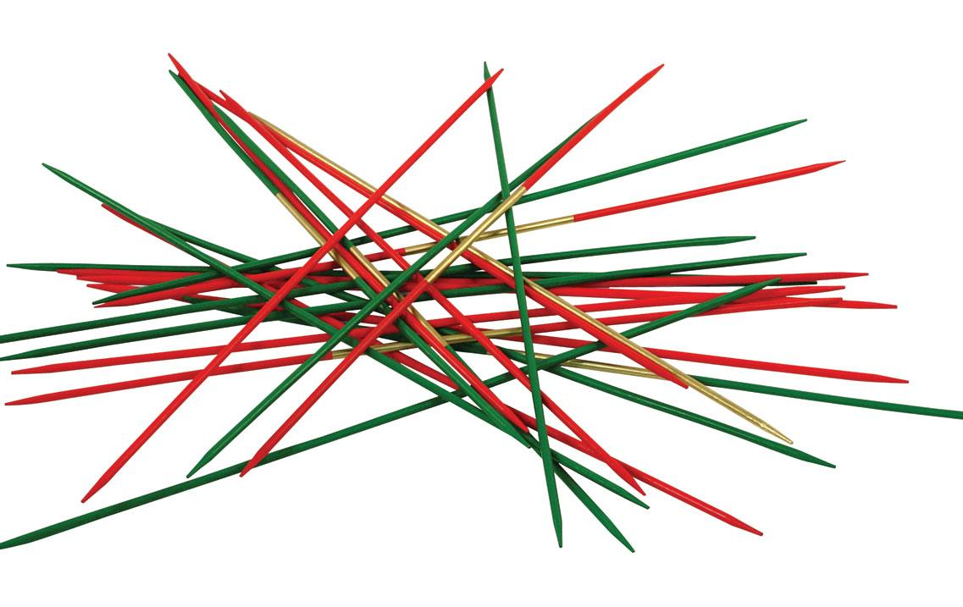
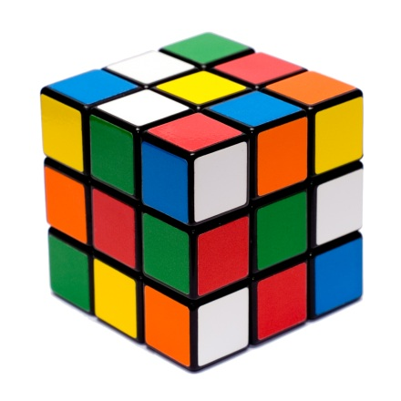
On Combinatorial vs Algebraic Computational Problems
Boaz Barak – MSR New England
Based on joint works with Benny Applebaum, Guy Kindler, David Steurer, and Avi Wigderson
Erdős Centennial, Budapest, July 2013

Slide 2
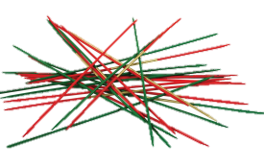
Heuristic Classification of Computational Problems
“Combinatorial” / “Unstructured”
Boolean Satisfiability, Graph Coloring, Clique, Stable Set, …
Simple algorithms (greedy, convex optimization, ….)
Either very easy or very hard (NP-hard, “$NP∩coNP=P"$)
Useful for Private-Key Cryptography
“Algebraic” / “structured”
Integer Factoring, Primality Testing, Discrete Logarithm, Matrix Multiplication, …
Surprising algorithms (cancellations, manipulations,…)
Often intermediate difficulty (subexp, quantum, $NP∩coNP$ )
Useful for (private and) Public-Key Crypto

Slide 3
Heuristic Classification of Computational Problems
“Combinatorial” / “Unstructured”
Boolean Satisfiability, Graph Coloring, Clique, Stable Set, …
Simple algorithms (greedy, convex optimization, ….)
Either very easy or very hard (NP-hard, “$NP∩coNP=P"$)
Unproven Thesis:
Useful for Private-Key Cryptography
Classification captures a real phenomena.
For many “combinatorial” problems, “best” algorithm is one of few possibilities.
“Algebraic” / “structured”
Integer Factoring, Primality Testing, Discrete Logarithm, Matrix Multiplication, …
Surprising algorithms (cancellations, manipulations,…)
Often intermediate difficulty (subexp, quantum, $NP∩coNP$ )
Useful for (private and) Public-Key Crypto

Slide 4
Research Questions
Can we make this classification formal?
Can we predict whether combinatorial problems are easy or hard?
Is there a general way to figure out the optimal algorithm for a combinatorial problem?
Could be particularly useful for average-case problems.
Is algebraic structure necessary for exponential quantum speedup?
What could we do with an 100 qubit quantum computer?
Is algebraic structure necessary for public key cryptography?
Can we build public key cryptosystems resilient to quantum attacks?
Principled reasons to assume non-existence of surprising classical attacks?

Slide 5
This Talk
Can we make this classification formal?
Can we predict whether combinatorial problems are easy or hard?
Is there a general way to figure out the optimal algorithm for a combinatorial problem?
Could be particularly useful for average-case problems.
“meta-conjecture” on optimal algorithm for random constraint satisfaction problems.
[B-Kindler-Steurer ‘13]
Is algebraic structure necessary for exponential quantum speedup?
What could we do with an 100 qubit quantum computer?
Is algebraic structure necessary for public key cryptography?
Can we build public key cryptosystems resilient to quantum attacks?
Principled reasons to assume non-existence of surprising classical attacks?
Construction of public key encryption from random CSPs, expansion problems on graphs.
[Applebaum-B-Wigderson ‘10]
Phase transition between “combinatorial” and “algebraic” regimes

Slide 6
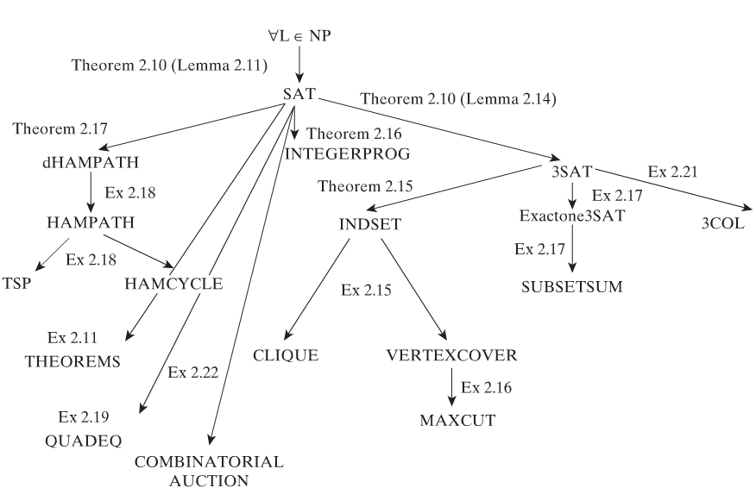
Part I: Average-Case Complexity of Combinatorial Problems
Canonical way of showing hardness: web of reductions
Reduction: Show problem A no harder than B, by mapping A-instance $φ$ to B-instance $ψ$ s.t. solution for $ψ$ can be mapped back to sol’n for $φ$
$$φ$$
$$ψ=ψ(φ)$$
A solver
B solver
$$A(φ)$$
$$B(ψ)$$
Almost no reductions for average-case complexity.
Main Issue: Reductions don’t maintain natural input distributions.
Typically map from $φ$ to $ψ$ introduces gadgets, grows instances size $(\left|ψ\right|>\left|φ\right|)$
In particular even if $φ$ is uniform, $ψ$ is not.
As a result, in average-case complexity we have a collection of problems with very few relations known between them
(Integer Factoring, Random k-SAT, Planted Clique, Learning Parity with Noise, …)

Slide 7
Alternative Approach to Showing Hardness
Instead of conjecturing one problem hard and reducing many problems to it…
Conjecture a single algorithm $𝒜$ is optimal for all problems in a large class $𝒞$
Reduces checking if $X∈𝒞$ is hard or easy to analyzing $𝒜$’s performance on $X$
Main Challenge: Can we find such conjecture that is both true and useful?
What evidence can support such a conjecture?
Attempt [B-Kindler-Steurer’13]: The basic semi-definite program is optimal for random constraint satisfaction problems.
Natural convex optimization
Generalization of Lovász $θ$ function.
Next:
Precise formulation
Applications
Evidence
See also [Raghavendra ‘08]

Slide 8
Optimal Algorithm for Random CSP’s
Prototypical combinatorial problem:
Predicate $P:{\left\{0,1\right\}}^{k}→\{0,1\}$ (e.g., $P\left(x,y,z\right)=x∨y∨z$ for 3SAT)
Instance $φ$ of $CSP(P)$: $k$-tuples $C_{1},…,C_{m}$ of literals over variables $x_{1},…,x_{n}$
e.g., $C_{i}(x)=(y_{i,1},…,y_{i,k})$ where each $y_{i,j}$is some variable $x_{ℓ}$ or its negation ${\overline{x}}_{ℓ}$.
$$val\left(φ\right):=\max_{x∈{\left\{0,1\right\}}^{n}}{\frac{1}{m}\sum_{i=1}^{m}{P\left(C_{i}(x)\right)}}$$
Relaxation for $CSP(P)$: Algorithm $ℛ$ s.t. $ℛ\left(φ\right)≥val(φ)$ for all $φ$
Random $CSP(P)$: $C_{1},…, C_{m}$ chosen at random, $m≫n$ (overconstrained regime)
The probabilistic (Erdős) method $⇒$ $val\left(φ\right)≅𝔼 P(U_{k})$ non-constructively
Hypothesis [B-Kindler-Steurer’13]: $∀P$ the Basic SDP relaxation $SDP_{P}$ is the tightest efficient relaxation for random $CSP(P)$:
$∀$ efficient relaxation $ℛ$ and $ε>0$ it holds that $𝔼 \left[ℛ\left(φ\right)\right]≥𝔼 [SDP_{P}\left(φ\right)]−ε$

Slide 9
Optimal Algorithm for Random CSP’s
Prototypical combinatorial problem:
Predicate $P:{\left\{0,1\right\}}^{k}→\{0,1\}$ (e.g., $P\left(x,y,z\right)=x∨y∨z$ for 3SAT)
Instance $φ$ of $CSP(P)$: $k$-tuples $C_{1},…,C_{m}$ of literals over variables $x_{1},…,x_{n}$
e.g., $C_{i}(x)=(y_{i,1},…,y_{i,k})$ where each $y_{i,j}$is some variable $x_{ℓ}$ or its negation ${\overline{x}}_{ℓ}$.
$$val\left(φ\right):=\max_{x∈{\left\{0,1\right\}}^{n}}{\frac{1}{m}\sum_{i=1}^{m}{P\left(C_{i}(x)\right)}}$$
Relaxation for $CSP(P)$: Algorithm $ℛ$ s.t. $ℛ\left(φ\right)≥val(φ)$ for all $φ$
Random $CSP(P)$: $C_{1},…, C_{m}$ chosen at random, $m≫n$ (overconstrained regime)
The probabilistic (Erdős) method $⇒$ $val\left(φ\right)≅𝔼 P(U_{k})$ non-constructively
Hypothesis [B-Kindler-Steurer’13]: $∀P$ the Basic SDP relaxation $SDP_{P}$ is the tightest efficient relaxation for random $CSP(P)$:
$∀$ efficient relaxation $ℛ$ and $ε>0$ it holds that $𝔼 \left[ℛ\left(φ\right)\right]≥𝔼 [SDP_{P}\left(φ\right)]−ε$

Slide 10
$$val\left(φ\right)=\max_{x∈{\left\{0,1\right\}}^{n}}{\frac{1}{m}\sum_{i=1}^{m}{P\left(C_{i}(x)\right)}}$$
Instance $φ$ of $CSP(P)$ : $k$-tuples $C_{1},…,C_{m}$ of literals over $x_{1},…,x_{n}$
Relaxation: $ℛ$ s.t. $ℛ\left(φ\right)≥val(φ)$ for all $φ$
Random instance: $val\left(φ\right)≅𝔼P(U_{k})$
Hypothesis [B-Kindler-Steurer’13]: $∀P$ the Basic SDP relaxation $SDP_{P}$ is the tightest efficient relaxation for random $CSP(P)$:
$∀$ efficient relaxation $ℛ$ and $ε>0$ it holds that $𝔼 \left[ℛ\left(φ\right)\right]≥𝔼 [SDP_{P}\left(φ\right)]−ε$
Hypothesis implies: Random $CSP\left(P\right)$ is hard to certify iff $𝔼\left[ SDP_{P}\left(φ\right)\right]>𝔼 P(U_{k})$
Theorem: $𝔼\left[ SDP_{P}\left(φ\right)\right]=\max_{D}{𝔼 P(D)}$ over $D$ pairwise independent dist over ${\left\{0,1\right\}}^{k}$
Predicate
$${𝔼 P(U_{k})}$$
$$\max_{D}{𝔼 P(D)}$$
3XOR
$$1/2$$
$$1$$
3SAT
$$7/8$$
$$1$$
MAX-CUT
$$1/2$$
$$1/2$$

Slide 11
$$val\left(φ\right)=\max_{x∈{\left\{0,1\right\}}^{n}}{\frac{1}{m}\sum_{i=1}^{m}{P\left(C_{i}(x)\right)}}$$
Instance $φ$ of $CSP(P)$ : $k$-tuples $C_{1},…,C_{m}$ of literals over $x_{1},…,x_{n}$
Relaxation: $ℛ$ s.t. $ℛ\left(φ\right)≥val(φ)$ for all $φ$
Random instance: $val\left(φ\right)≅𝔼P(U_{k})$
Hypothesis [B-Kindler-Steurer’13]: $∀P$ the Basic SDP relaxation $SDP_{P}$ is the tightest efficient relaxation for random $CSP(P)$:
$∀$ efficient relaxation $ℛ$ and $ε>0$ it holds that $𝔼 \left[ℛ\left(φ\right)\right]≥𝔼 [SDP_{P}\left(φ\right)]−ε$
Hypothesis implies: Random $CSP\left(P\right)$ is hard to certify iff $𝔼\left[ SDP_{P}\left(φ\right)\right]>𝔼 P(U_{k})$
Theorem: $𝔼\left[ SDP_{P}\left(φ\right)\right]=\max_{D}{𝔼 P(D)}$ over $D$ pairwise independent dist over ${\left\{0,1\right\}}^{k}$
Predicate
$${𝔼 P(U_{k})}$$
$$\max_{D}{𝔼 P(D)}$$
3XOR
$$1/2$$
$$1$$
3SAT
$$7/8$$
$$1$$
MAX-CUT
$$1/2$$
$$1/2$$

Slide 12
Hypothesis [B-Kindler-Steurer’13]: $∀P$ the Basic SDP relaxation $SDP_{P}$ is the tightest efficient relaxation for random $CSP(P)$
Applications: Hardness of approx for Expanding Label Cover, Densest Subgraph, characterization of “approximation resistant” predicates.
Evidence:
Coincides with Feige’s Hypothesis for 3-ary predicates.
Sometimes proven that potentially stronger algorithms (SDP hierarchies) do not outperform Basic CSP.
Some hardness of approximation “predictions” verified. [Chan ‘13]

Slide 13
Part II: Structure and Public Key Crypto
Public Key Cryptography (Diffie-Hellman ‘76): Two parties can communicate confidentially without a shared secret key
All widely deployed variants based on Integer Factoring or related problems (RSA, discrete log, elliptic curve dlog, etc..).
Significant structure:
Non-trivial algorithms (e.g., $\exp^{∗}⁡(n^{1/3})$ for factoring [Buhler-Lenstra-Pomerance ‘94])
Cannot be NP-hard (inside $NP∩coNP$ or $AM∩coAM$ , etc..)
Quantum polynomial time algorithm [Shor ‘94].
Can we be sure the current classical algorithms are optimal?
e.g., halving the exponent for factoring will square the key size for RSA and will increase running time to the 4th to 6th power.

Slide 14
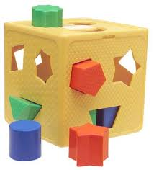
Is Structure needed for Public Key Crypto?
Current best (only?) public-key alternative: Lattice-based crypto.
Hardness of lattice problems for given approximation factor*
$$\sqrt{n}$$
$$2^{n}$$
$NP$-hard “unstructured”
Useful for public key crypto
Polynomial time
In $NP∩coNP$ [Goldreich-Goldwasser 98, Aharonov-Regev ‘04]
“structured”?
Is there “combinatorial”/”unstructured” public-key crypto?
Perhaps give more confidence that known attacks are optimal?

Slide 15
Public-Key Crypto from Random 3SAT
Theorem 1 [Applebaum-B-Wigderson ’10]: Can build public-key crypto from (problem related to) random 3SAT
Hardness of random 3SAT for given number of clauses*
$$n^{}$$
$$n^{1.2}$$
$$n^{1.5}$$
Hard? “unstructured”?
Useful for PKC
Polynomial time
In* $NP∩coNP$ [Feige-Kim-Ofek ‘06]
“structured”?
Not a satisfactory answer….

Slide 16
Public-Key Crypto from Random 3SAT
Theorem 1 [Applebaum-B-Wigderson ’10]: Can build public-key crypto from (problem related to) random 3SAT
Hardness of random 3SAT for given number of clauses*
$$n^{}$$
$$n^{1.2}$$
$$n^{1.5}$$
Hard? “unstructured”?
Useful for PKC
Polynomial time
In* $NP∩coNP$ [Feige-Kim-Ofek ‘06]
“structured”?
Not a satisfactory answer….

Slide 17
$$n^{}$$
$$n^{1.2}$$
$$n^{1.5}$$
Hard? “unstructured”?
Useful for PKC
Polynomial time
In* $NP∩coNP$ [Feige-Kim-Ofek ‘06]
“structured”?
Theorem 2 [Applebaum-B-Wigderson ’10]: Can build PKC from (problem related to) random 3SAT in “unstructured regime” and random “unbalanced expansion” problem.
No known $NP∩coNP$ attacks on the “unbalanced expansion” problem
…but structure and critical parameters are yet to be fully understood.
Not (yet?) a satisfactory answer….

Slide 18
(Some of the many) Open Questions
Justify/refute intuition that some classes of problems have single optimal algorithm.
Vefirify/refute hardness-of-approx predictions of [BKS] hypothesis.
Find more “meta-conjectures” on optimal algorithms.
... in particular for under-constrained CSP’s (see [Achlioptas Coja-Oghlan ‘12])
Relations between structure and quantum speedup..
..candidate hard distributions for combinatorial problems with quantum speedup?
More candidate public key cryptosystems..
.. and better ways to classify their “structure”.

