Slide 1
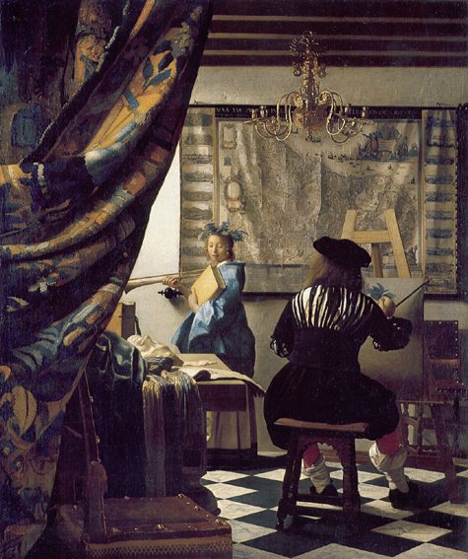
New trends in geometric hypergraph coloring
Shakhar Smorodinsky
Ben-Gurion University, Be’er-Sheva

Slide 2
Color s.t. touching pairs have distinct colors
How many colors suffice?

Slide 3
Four colors suffice by Four-Color-THM
Planar graph

Slide 4
4 colors suffice s.t. point covered by two discs is non-monochromatic

Slide 5
What about (possibly) overlapping discs?
Color s.t. every point is covered with a non-monochromatic set
Thm [S 06] : 4 colors suffice!
Obviously we “have” to use the Four-Color-Thm

Slide 6
In fact .. Holds for pseudo-discs but with a larger constant c

Slide 7
How about 2 colors but worry only about
“deep” points.
If possible, how deep should pts be?

Slide 9
Geometric Hypergraphs:
Type 1
Pts w.r.t ‘’something” (e.g., all discs)
P = set of pts
D = family of all discs
We obtain a hypergraph (i.e., a range space)
H = (P,D)

Slide 10
Geometric Hypergraphs:
Type 1
Pts w.r.t ‘’something” (e.g., all discs)
P = set of pts
D = family of all discs
We obtain a hypergraph (i.e., a range space)
H = (P,D)

Slide 11
Geometric Hypergraphs:
Type 1
Pts w.r.t ‘’something” (e.g., all discs)
P = set of pts
D = family of all discs
We obtain a hypergraph (i.e., a range space)
H = (P,D)

Slide 12
Geometric Hypergraphs:
Type 2
Hypergraphs induced by “something” (e.g., a finite family of ellipses)
D={1,2,3,4}, H(D) = (D,E),
E = { {1}, {2}, {3}, {4},{1,2}, {2,4},{2,3}, {1,3}, {1,2,3} {2,3,4}, {3,4} }
1
4
2
3

Slide 13
Polychromatic Coloring
R = infinite family of ranges (e.g., all discs)
P = finite set
(P,R) = range-space
A k-coloring of points
Def: region r Є R is polychromatic if it contains all k colors
polychromatic
polychromatic

Slide 14
Polychromatic Coloring
Def: region r Є R is
c-heavy if it contains c points
R = infinite family of ranges (e.g., all discs)
P = a finite point set
Q: Is there a constant, c s.t.
∀ set P ∃ 2-coloring s.t,
∀ c-heavy region r Є R is polychromatic?
4-heavy
More generally:
Q: Is there a function, f=f(k) s.t.
∀ set P ∃ k-coloring s.t,
∀ f(k)-heavy region is polychromatic?
Note: We “hope” f is independent of the size of P !

Slide 15
Related Problems
Sensor cover problem
[Buchsbaum, Efrat, Jain, Venkatasubramanian, Yi 07]
Covering decomposition problems
[Pach 80], [Pach 86], [Mani, Pach 86] ,
[Pach, Tóth 07], [Pach, Tardos, Tóth 07],
[Tardos, Tóth 07], [Pálvölgyi, Tóth 09],
[Aloupis, Cardinal, Collette, Langerman, S 09]
[Aloupis, Cardinal, Collette, Langerman, Orden, Ramos 09]
Disks are sensors.

Slide 16
Related Problems
Sensor cover problem
[Buchsbaum, Efrat, Jain, Venkatasubramanian, Yi 07]
Covering decomposition problems
[Pach 80], [Pach 86], [Mani, Pach 86] ,
[Pach, Tóth 07], [Pach, Tardos, Tóth 07],
[Tardos, Tóth 07], [Pálvölgyi, Tóth 09],
[Aloupis, Cardinal, Collette, Langerman, S 09]
[Aloupis, Cardinal, Collette, Langerman, Orden, Ramos 09]

Slide 17
Related Problems
Sensor cover problem
[Buchsbaum, Efrat, Jain, Venkatasubramanian, Yi 07]
Covering decomposition problems
[Pach 80], [Pach 86], [Mani, Pach 86] ,
[Pach, Tóth 07], [Pach, Tardos, Tóth 07],
[Tardos, Tóth 07], [Pálvölgyi, Tóth 09],
[Aloupis, Cardinal, Collette, Langerman, S 09]
[Aloupis, Cardinal, Collette, Langerman, Orden, Ramos 09]

Slide 18
Related Problems
Sensor cover problem
[Buchsbaum, Efrat, Jain, Venkatasubramanian, Yi 07]
Covering decomposition problems
[Pach 80], [Pach 86], [Mani, Pach 86] ,
[Pach, Tóth 07], [Pach, Tardos, Tóth 07],
[Tardos, Tóth 07], [Pálvölgyi, Tóth 09],
[Aloupis, Cardinal, Collette, Langerman, S 09]
[Aloupis, Cardinal, Collette, Langerman, Orden, Ramos 09]
A covered point

Slide 19
Major Challenge
Fix a compact convex body B
Put R = family of all translates of B
Conjecture [J. Pach 80]: ∃ f=f(2) !
Namely: Any finite set P can be 2-colored s.t.
any translate of B containing at least f points of P is polychromatic.

Slide 20
Why Translates?
Thm: [Pach, Tardos, Tóth 07]:
∀c ∃ P ∀2-coloring
c –heavy disc
which is monochromatic.
Arbitrary size discs:
no coloring for constant c can be guaranteed.

Slide 21
Why Convex?
Thm: [Pach, Tardos, Tóth 07] [Pálvölgyi 09]:
∀c ∃ P ∀2-coloring
∃ c -heavy translate of
a fixed concave polygon
which is monochromatic.

Slide 22
Some special cases are known:
Polychromatic coloring for other ranges:
Always: f(2) = O(log n) whenever VC-dimension is bounded
(easy exercise via Prob. Method)
Special cases: hyperedges are:
  Halfplanes:
  f(k) = O(k²) [Pach, Tóth 07]
  4k/3 ≤ f(k) ≤ 4k-1 [Aloupis, Cardinal, Collette, Langerman, S 09]
  f(k) = 2k-1 [S, Yuditsky 09]
  Translates of centrally symmetric open convex polygon,
  f(2) [ Pach 86]
  f(k) = O(k²) [Pach, Tóth 07]
  f(k) = O(k) [Aloupis, Cardinal, Collette, Orden, Ramos 09]
  Unit discs
  f(2) [Mani, Pach 86] ? [Long proof…….. Unpublished….]
  Translates of an open triangle:
  f(2) [Tardos, Tóth 07]
  Translates of an open convex polygon:
  f(k) [Pálvölgyi, Tóth 09] and f(k)=O(k) [Gibson, Varadarajan 09]
  Axis parallel strips in R^{d}: f(k) ≤ O(k ln k) [ACCIKLSST]

Slide 23
Related Problems ε-nets
For a range space (P,R) a subset N is an ε-net if every range with
cardinality at least ε|P| also contains a point of N.
i.e., an ε-net is a hitting set for all ``heavy” ranges
How small can we make an ε-net N?
Thm: [Haussler Welzl 86]
ε-net of size O(d/ε log (1/ε)) whenever VC-dimension is constant d
Sharp! [Komlós, Pach, Woeginger 92]
Observation: Assume (as in the case of half-planes) that f(k) < ck
Put k=εn/c. Partition P into k parts each forms
an ε-net. By the pigeon-hole principle one of the parts has size
at most n/k = c/ε
Thm: [Woeginger 88] ∃ ε-net for half-planes of size
at most 2/ε.
A stronger version:
Thm:[S, Yuditsky 09] ∀ ε ∃ partition of P into < εn/2 parts
s.t. each part form an ε-net.

Slide 24
Related Problems
Discrepancy
A range space (P,R) has discrepancy d if P can be two colored
so that any range r Є R is d-balanced.
I.e., in r |# red - # blue | ≤ d.
Note: A constant discrepancy d implies f(2) ≤ d+1.

Slide 25
Related Problems
Relaxed graph coloring
Let G be a graph.
Thm [Haxell, Szabó, Tardos 03]:
If Δ(G) ≤ 4 then G can be 2-colored s.t,
every monochromatic connected component
has size ≤ 6
In other words. Every graph G with Δ(G) ≤ 4 can be 2-colored
So that every connected component of size ≥ 7 is polychromatic.
Remark: For Δ(G) ≤ 5 their thm holds with size of componennts ??? instead of 6
Remark: For Δ(G) ≥ 6 the statement is wrong!

Slide 26
A simple example with axis-parallel strips
Question reminder:
Is there a constant c, s.t.
for every set P
∃ 2-coloring s.t,
every c-heavy strip is polychromatic?
All 4-Strips are polychromatic,
but not all 3-Strips are.

Slide 27
A simple example with axis-parallel strips
Observation:
c ≤ 7.
Follows from:
Thm [Haxell, Szabó, Tardos 03]:
Reduction:
Let G = (P, E)
E = pairs of consecutive points (x or y-axis):
Δ(G) ≤ 4
⇒ ∃2-coloring ∀ monochromatic c-heavy strip, c ≤ 6.
The graph G derived from
the points set P.

Slide 28
Coloring points for strips
Could c = 2 ?
No.
So: 3 ≤ c ≤ 7
In fact: c = 3
Thm: [ACCIKLSST] There exists a 2-coloring
s.t, every 3-heavy strip is
Polychromatic
General bounds: 3k/2 ≤ f(k) ≤ 2k-1
No 2-coloring is polychromatic
for all 2-heavy strips

Slide 29
Coloring points for halfplanes
2k-2 pts not
polychromatic
Thm [S, Yuditsky 09]:
f(k)=2k-1
Lower bound
2k-1 ≤ f(k)
2k-1 pts
n-(2k-1) pts

Slide 30
Coloring points for halfplanes
Upper bound
f(k) ≤ 2k-1
Pick a
minimal hitting set
P’ from CH(P)
for all 2k-1 heavy halfplanes
Lemma:
Every 2k-1 heavy halfplane contains
≤ 2 pts of P’

Slide 31
Coloring points for halfplanes
Upper bound
f(k) ≤ 2k-1
Recurse on P\P’ with 2k-3
Stop after k iterations
easy to check..

Slide 32
Related Problems
Relaxed graph coloring
Thm [Alon et al. 08]:
The vertices of any plane-graph can be k-colored
so that any face of size at least ~4k/3 is polychromatic

Slide 33
Part II: Conflict-Free Coloring
and its relatives
A Hypergraph H=(V,E)
χ: V → {1,…,k} is a Conflict-Free coloring (CF) if every hyperedge contains some unique color
CF-chromatic number χ_{CF}(H) = min #colors needed to CF-Color H

Slide 34
CF for Hypergraphs induced by regions?
A CF Coloring of n regions
Any point in the union is contained in at least one region whose color is ‘unique’
1
2
1
1

Slide 35
Motivation for CF-colorings
Frequency Assignment in cellular networks
1
1
2

Slide 36
Goal: Minimize the total number of frequencies

Slide 37
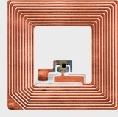
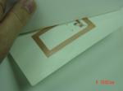
More motivations: RFID-tags network
RFID tag: No battery needed. Can be triggered by a reader to trasmit data (e.g., its ID)

Slide 38
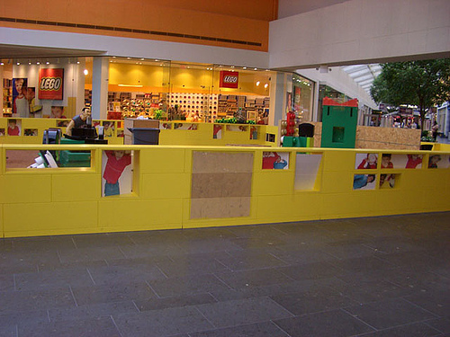
Leggo land

Slide 39
More motivations: RFID-tags network
Tags and …
Readers
A tag can be read at a given time only if one reader is triggering a read action

Slide 40
RFID-tags network (cont)
Tags and …
Readers
Goal: Assign time slots to readers from {1,..,t} such that all tags are read. Minimize t

Slide 41
Problem: Conflict-Free Coloring of
Points w.r.t Discs
Any (non-empty) disc contains a unique color
1
4
3
2
4
3
3
2
1

Slide 42
Problem: Conflict-Free Coloring of
Points w.r.t Discs
Any (non-empty) disc contains a unique color
1
1
3
2
4
3
3
2
1

Slide 43
How many colors are necessary ? (in the worst case)
Lower Bound
log n
Easy:
Place n points on a line
n pts
≥ log n colors
≥n/2
≥ n/4
1
3
2

Slide 44
CF-coloring points w.r.t discs (cont)
Remark: Same works for any n pts in convex position
Thm: [Pach,Tóth 03]:
Any set of n points in the plane needs Ω(log n) colors.

Slide 45
Points on a line: Upper Bound (cont)
log n colors suffice (when pts colinear)
Divide & Conquer (induction)
1
3
2
3
1
3
2
3
Color median with 1
Recurse on right and left
Reusing colors!

Slide 46
Old news
[Even, Lotker, Ron, S, 2003]
Any n discs can be CF-colored with O(log n) colors. Tight!
[Har-Peled, S 2005]
Any n pseudo-discs can be CF-colored with O(log n) colors.
Any n axis-parallel rectangles can be CF-colored with O(log² n) colors.
More results different settings (i.e., coloring pts w.r.t various ranges, online algorithms, relaxed coloring versions etc…)
[Chen et al. 05], [S 06], [Alon, S 06],
[Bar-Noy, Cheilaris, Olonetsky, S 07],
[Ajwani, Elbassioni, Govindarajan, Ray 07]
[Chen, Pach, Szegedy, Tardos 08], [Chen, Kaplan, Sharir 09]

Slide 47
Major challenges
Problem 1:
n discs with depth ≤ k
Conjecture: O(log k) colors suffice
If every disc intersects ≤ k other discs then:
Thm [Alon, S 06]:
O(log³k) colors suffice
Recently improved to
O(log²k) [S 09]:

Slide 48
Major challenges
Problem 2:
n pts with respect to axis-parallel rectangles
Best known bounds:
Upper bound:
[Ajwani, Elbassioni, Govindarajan, Ray 07]:
Õ(n^{0.382+ε}) colors suffice
Lower bound:
[Chen, Pach, Szegedy, Tardos 08]:
Ω(log n/log² log n) colors are sometimes necessary

Slide 49
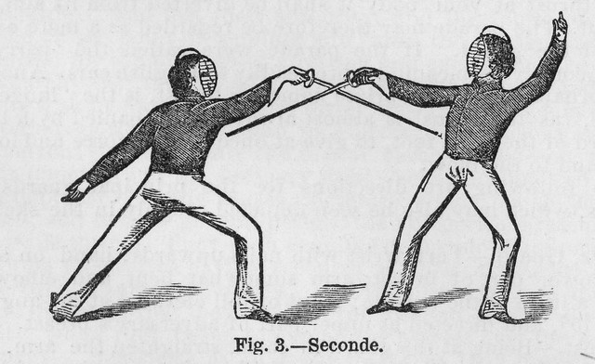
Major challenges
Problem 3:
n pts on the line inserted dynamically by an ENEMY
Best known bounds:
Upper bound:
[Chen et al.07]:
O(log²n) colors suffice
Only the trivial Ω(log n)
bound (from static case) is known.

Slide 50
Major challenges
Problem 4:
n pts in R³
A 2d simplicial complex (triangles pairwise openly disjoint)
Color pts such that no triangle is monochromatic!
How many colors suffice?
Observation:
O(√n) colors suffice
(3 uniform hypergraph with max degree n)
Whats the connection with CF-coloring
There is: Trust me.

Slide 51
Köszönöm
Ébredj fel!

