Slide 1
A Space-Time Formalism with Negative Mass to describe Antimatter and Dark Energy
Antoine A.J. van de Ven
Logic and Relativity Conference 2012

Slide 2
Space-time vs Space-propertime

Slide 3
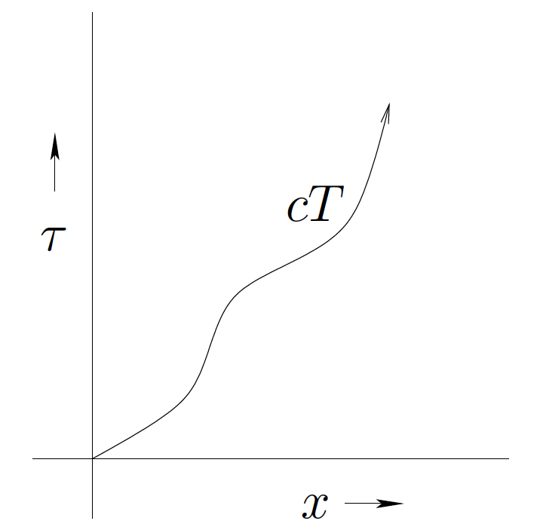
Space-time vs Space-proper

Slide 4
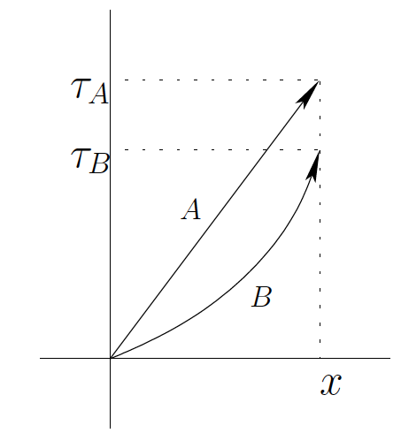
Twin-paradox visually explained

Slide 5
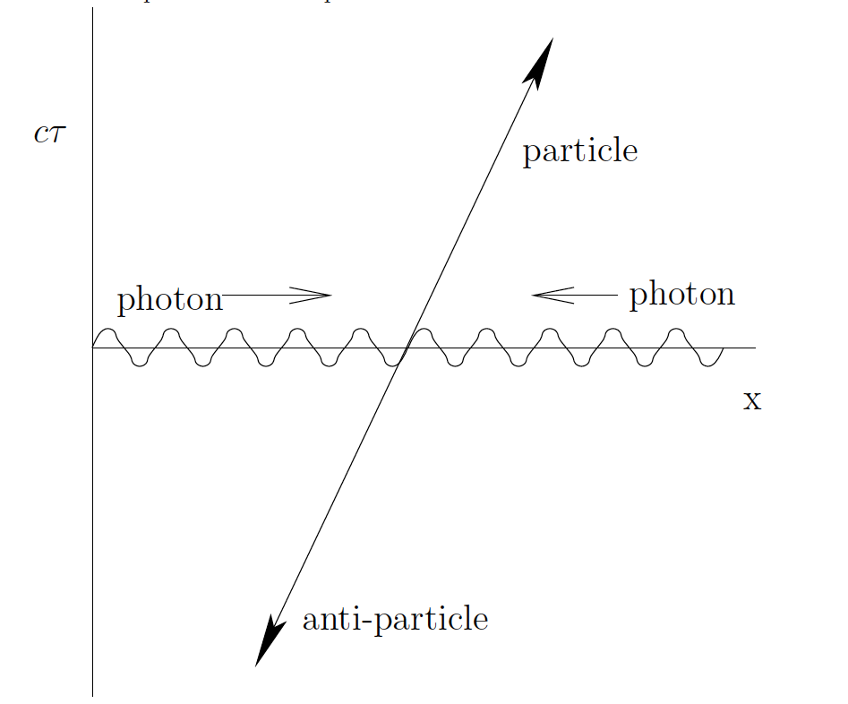

Slide 6
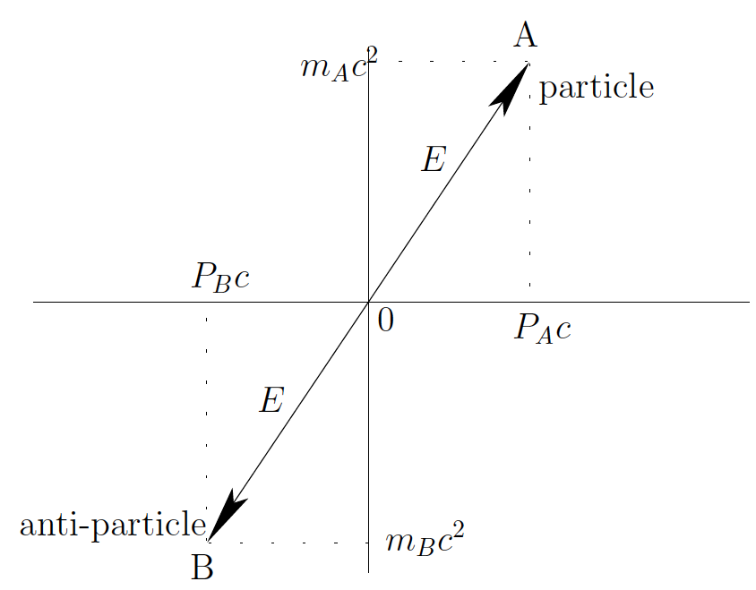
Negative Mass by symmetry

Slide 8
Generalized definition for Energy

Slide 9
Generalized definition for Energy

Slide 10
Generalized definition for momentum

Slide 11
Generalized definition for 4-momentum

Slide 12
Electromagnetism

Slide 13
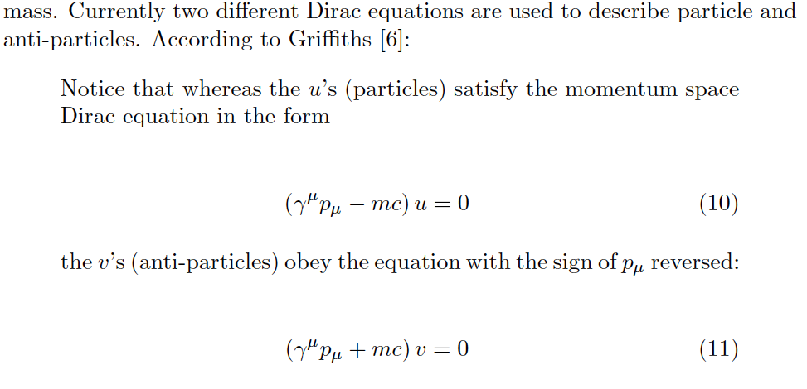
Quantum Mechanics

Slide 14
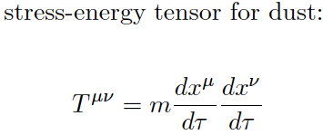
Gravitation : Not equal!
Negative for antimatter!

Slide 15
Anti-matter as Dark Energy
Causes anti-gravitational fields and effects because of negative mass
Is dark because it cannot form stars
Will distribute itself because it self-repels
Will be between galaxies and repels them (accelerated expansion of the universe)

Slide 16
Explains missing anti-matter in the universe
Equal amounts of matter and anti-matter could have been produced at the start of the universe.
Anti-matter is just hidden as Dark Energy, and away from us because it repels everything (and annihilates and disappears easily near matter like in a galaxy)

Slide 17
Predicts CP-Violation

Slide 18
Solves Vacuum-energy problem
Predicted by standard model/QED:
Experimentally (upper limit cosmological constant):

Slide 19
Solves Vacuum-energy problem
Vacuum energy is related to quantum fluctuations in the vacuum
Always equal amount of (virtual) particles and anti-particles in the vacuum
Anti-gravitational fields of antiparticles cancel gravitational fields of the particles (in the quantum fluctuations of the vacuum), so is in agreement with experimental value.

Slide 20
Anti-particles follow geodesics so are predicted to fall down on Earth

Slide 21
Prediction that (neutral) antiparticles will gravitationally repel each other
It is proposed to test and measure this experimentally

Slide 22
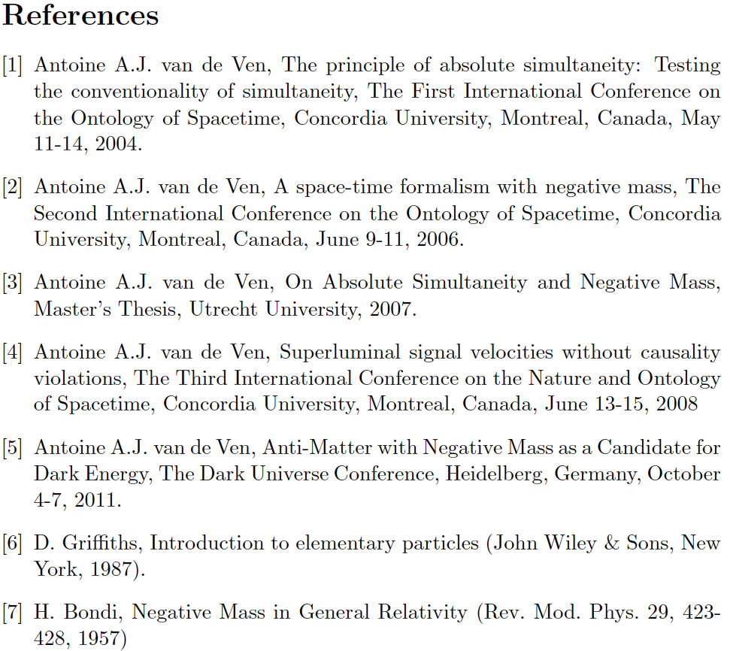

Slide 23
Gravitation : Not equal!

Slide 24
Gravitation : Not equal!

Slide 25
Gravitation : Not equal!

Slide 26
Anti-particles follow geodesics too

